Slide 1
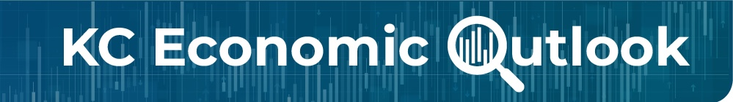
Welcome to the
2025 KC Economic Outlook Conference!
Hosted by:
Federal Reserve Bank of Kansas City
&
Mid-America Regional Council
Thursday, November 6th, 2025

Slide 2
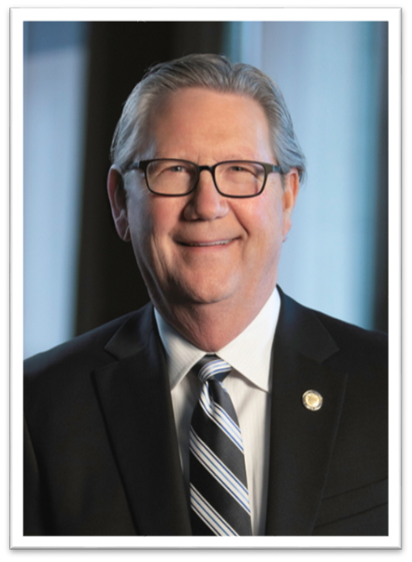
Jeff Schmid – President and Chief Executive Officer;
Federal Reserve Bank of Kansas City
Jeff represents the Tenth District on the Federal Open Market Committee, and is a voting member in 2025.
He leads a workforce of close to 2,000 employees in Kansas City and its branch offices in Omaha, Denver and Oklahoma City.
He joined the Federal Reserve in 2023.
He previously served as the President & Chief Executive Officer of the Southwestern Graduate School of Banking at Southern Methodist University.
He holds decades of experience leading banks, and began his career as an examiner for the FDIC.

Slide 3
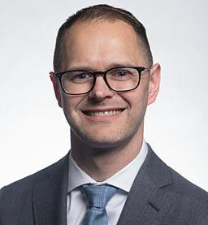
Lee Smith – Senior Vice President & Economist;
Federal Reserve Bank of Kansas City
Lee has oversight for macroeconomic research and serves as an advisor on monetary policy matters.
His research has included:
  The effects of expanding and unwinding Federal Reserve’s balance sheet.
  The impact of forward guidance on financial markets and the economy.
  How central bank communication can influence expectations and economic conditions.
He holds a Ph.D in economics from the University of Kansas and a B.A. in Economics and Mathematics from Drury University.

Slide 4
U.S. Economic Outlook
November 2025
Lee Smith
Senior Vice President & Economist
Federal Reserve Bank of Kansas City
The views herein are those of the presenter and are not official views of the Federal Reserve.

Slide 5
U.S. Economic Outlook
The economy is currently operating near the Federal Reserve’s dual mandate objectives.
However, the outlook for the economy is accompanied by upside risks to inflation and downside risks to employment.
Rising input costs are an upside risk to inflation, but thus far have been absorbed through lower profit margins. In a stronger demand environment, firms will likely pass through more of these cost increases.
A cooling in the labor market has kept inflationary pressures at bay, but a further cooling poses the risk that the labor market will slacken.

Slide 6
The economy is currently operating near the Fed’s dual mandate
Sources: Bureau of Labor Statistics, Bureau of Economic Analysis, Federal Reserve Board, Haver Analytics.

Slide 7
Tariffs are much higher now
Sources: U.S. Census Bureau (Haver Analytics), Yale Budget Lab

Slide 8
Not much imprint from tariffs in the inflation data thus far
Sources: Bureau of Economic Analysis, Federal Reserve Board, Haver Analytics

Slide 9
Even for goods prices, tariff effects are modest so far
Sources: Bureau of Economic Analysis, Haver Analytics

Slide 10
Tariff collections have increased substantially
Sources: U.S. Treasury, Haver Analytics

Slide 11
Little sign that foreign suppliers are lowering prices to offset the tariffs
Sources: Bureau of Labor Statistics, Haver Analytics

Slide 12
Firms across industries report paying higher input prices
Sources: Institute for Supply Management, Haver Analytics

Slide 13
Labor costs are rising, primarily due to large increases in health insurance expenses
Sources: Bureau of Labor Statistics, Haver Analytics
Notes: Both measures are from the Employment Cost Index for private industry workers

Slide 14
Profit margins are elevated, giving firms some scope to absorb higher input costs
Sources: Bureau of Economic Analysis, Haver Analytics

Slide 15
As we learned in recent years, firms will pass through higher costs when demand is strong
Sources: Bureau of Economic Analysis, Haver Analytics, Author’s Calculations

Slide 16
Job growth slowed sharply over the summer, but the unemployment rate only slightly increased
Sources: Bureau of Labor Statistics (Haver Analytics), Federal Reserve Bank of Kansas City
Notes: September forecasts are from Mustre-del-Rio, Oliyide, and Pollard (2025) An Alternative Version of the KC Fed LMCI Suggests Little Change in the Labor Market in September

Slide 17
A reduction in immigration is likely reducing the available supply of labor
2025 Estimate
Sources: Congressional Budget Office

Slide 18
Even as hiring slows, declines in labor supply are keeping the labor market broadly in balance
Sources: Bureau of Labor Statistics, Haver Analytics

Slide 19
Firms have slowed hiring, but have also been reluctant to lay off workers
Sources: BLS, Department of Labor, Haver Analytics

Slide 20
The low hiring, low firing labor market is a challenge for those entering the workforce
Sources: BLS (Haver Analytics), Federal Reserve Bank of New York

Slide 21
Policy is likely restrictive, but perhaps only modestly so
Sources: Federal Reserve Board, Federal Open Market Committee, Haver Analytics

Slide 22
The supply of government debt continues to grow
Sources: Congressional Budget Office, Committee for a Responsible Federal Budget

Slide 23
Slower population growth is likely to depress economic growth and interest rates
Sources: U.S. Census Bureau, Haver Analytics
Sources: Congressional Budget Office

Slide 24
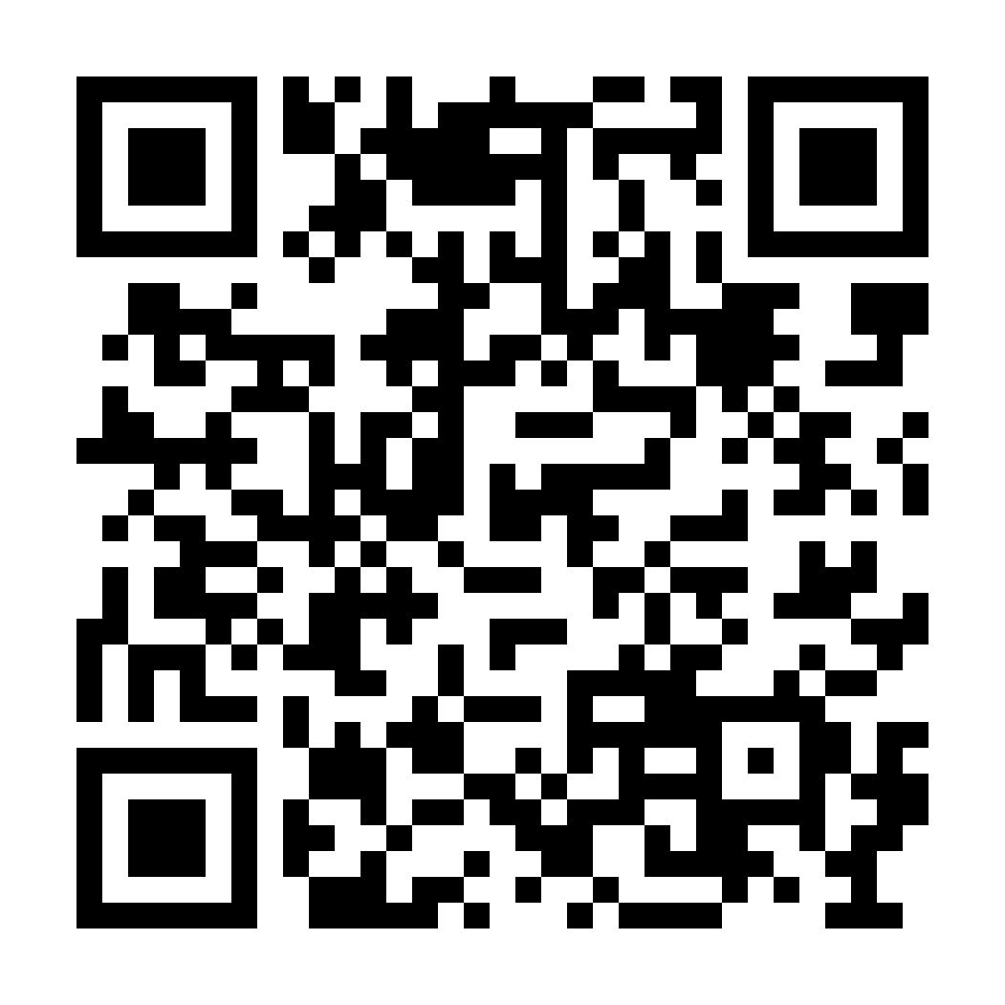
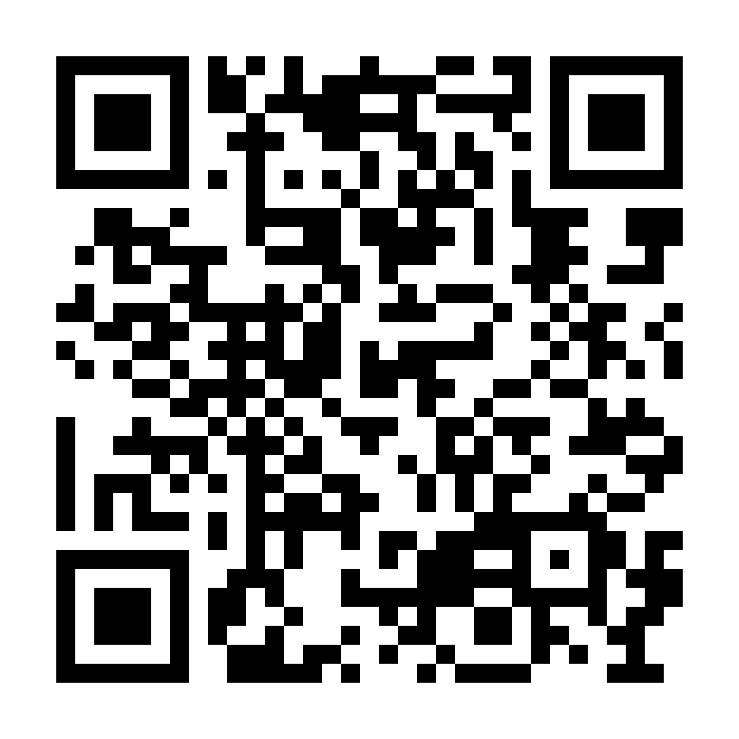
KC Fed Research
Email Alerts
Resources from the Kansas City Fed’s Economic Research Department
Charting the Economy
  Timely economic data curated by research staff at the Federal Reserve Bank of Kansas City.
Economic Bulletin
  Timely, accessible snapshots of the Kansas City Fed's latest economic findings and perspectives on national and international economic conditions and issues related to monetary policy, industries and markets.
Economic Review
  A quarterly research publication with articles on macroeconomics and monetary policy, regional and international economics, and banking and financial markets.
Stay up to date on our latest research: Subscribe to KC Fed Research Email Alerts (Right QR)

Slide 25

Jeremy Hill – Regional Executive & Assistant Vice President; Federal Reserve Bank of Kansas City
Jeremy serves as the Regional Economist for Missouri & Kansas.
He leads regional research initiatives regarding key industries and community issues across both states’ economies.
He coordinates strategic outreach initiatives to enhance the Fed’s connections throughout the two states.
Prior to joining the Fed, Jeremy spent 15 years as the Director for the Center of Economic Development & Business Research at Wichita State University
He holds a Bachelor’s in Business Administration and a Master of Public Administration, both from Georgia Southern University.

Slide 26
Economic Update
November 2025
Jeremy Hill
Assistant Vice President, Regional Executive
The views herein are those of the presenter and do not necessarily reflect those of the Federal Reserve Bank of Kansas City or the Federal Reserve System

Slide 27
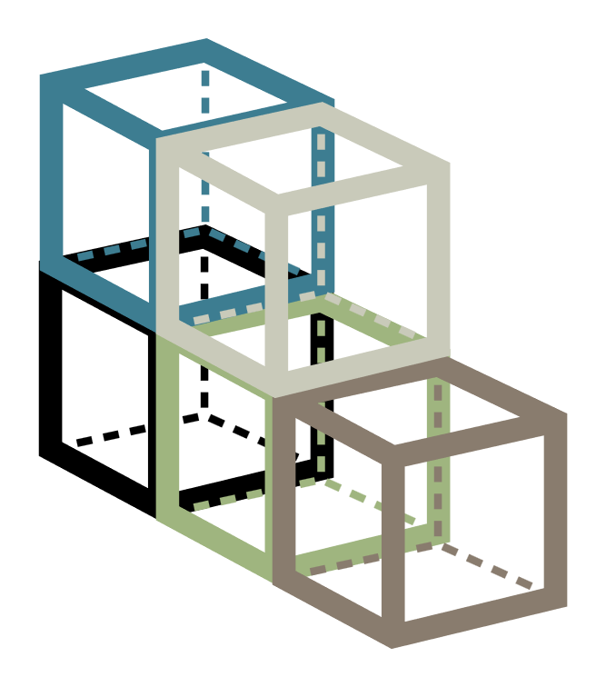



Economic progression of themes
2024
Fall – Economic Kaleidoscope
2025
Q1 – Economic Building Blocks
Q2 – Economic Tug-of-war
Q3 – Periscope
Q4 – Lane Assist

Slide 28
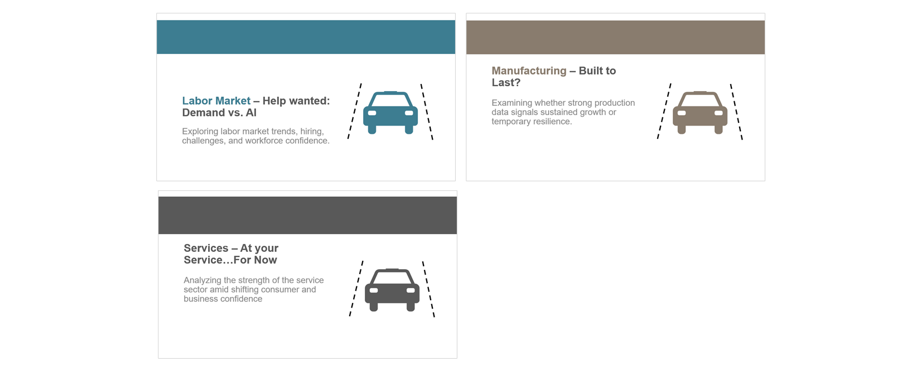
Lane Assist – Disciplined Navigation

Slide 29
Labor Market – Help wanted: Demand vs. AI
Exploring labor market trends, hiring, challenges, and workforce confidence.

Slide 30
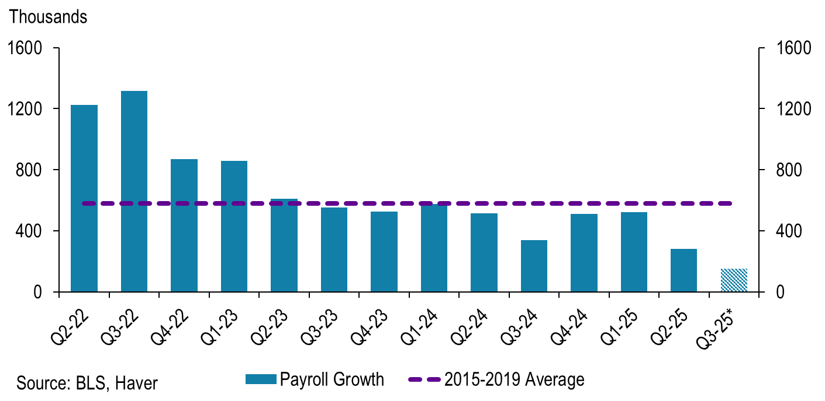
Labor is cooling, but so is supply
*Quarter 3 2025 estimated based on July and August numbers

Slide 31
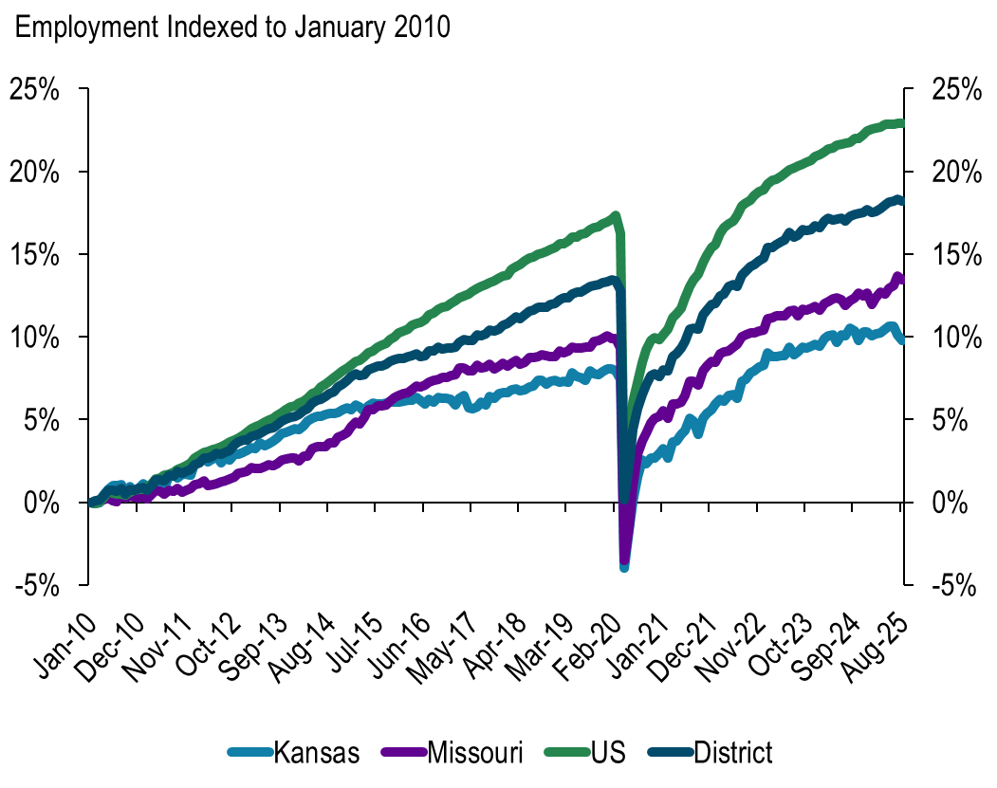
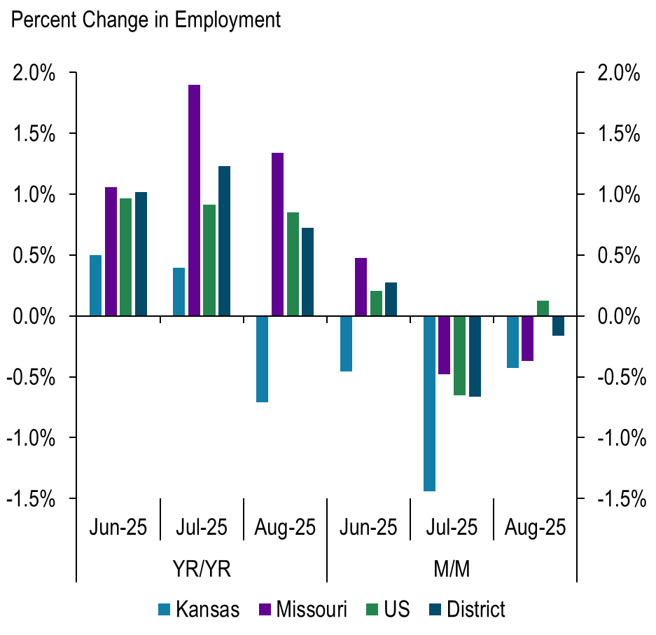
KS has slowed and MO appears to have picked up
Source: BLS

Slide 32
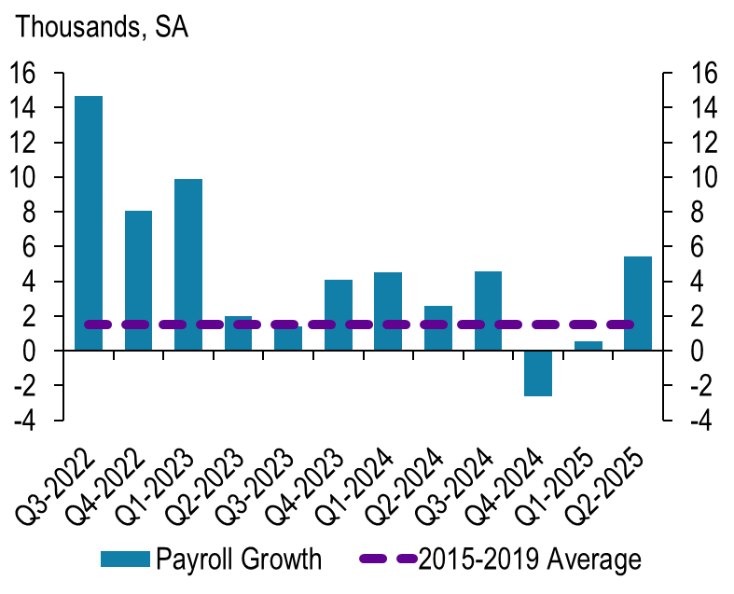
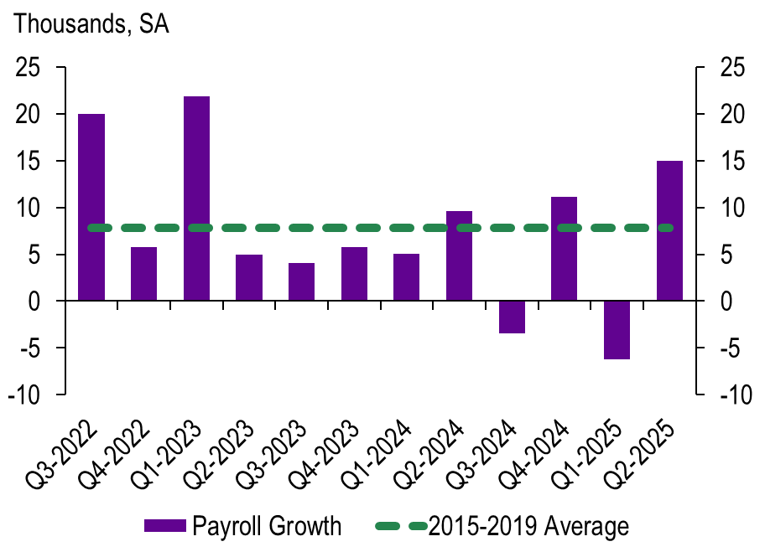
Growth is inline with previous tight labor markets
Kansas
Missouri
Source: BLS, Haver

Slide 33
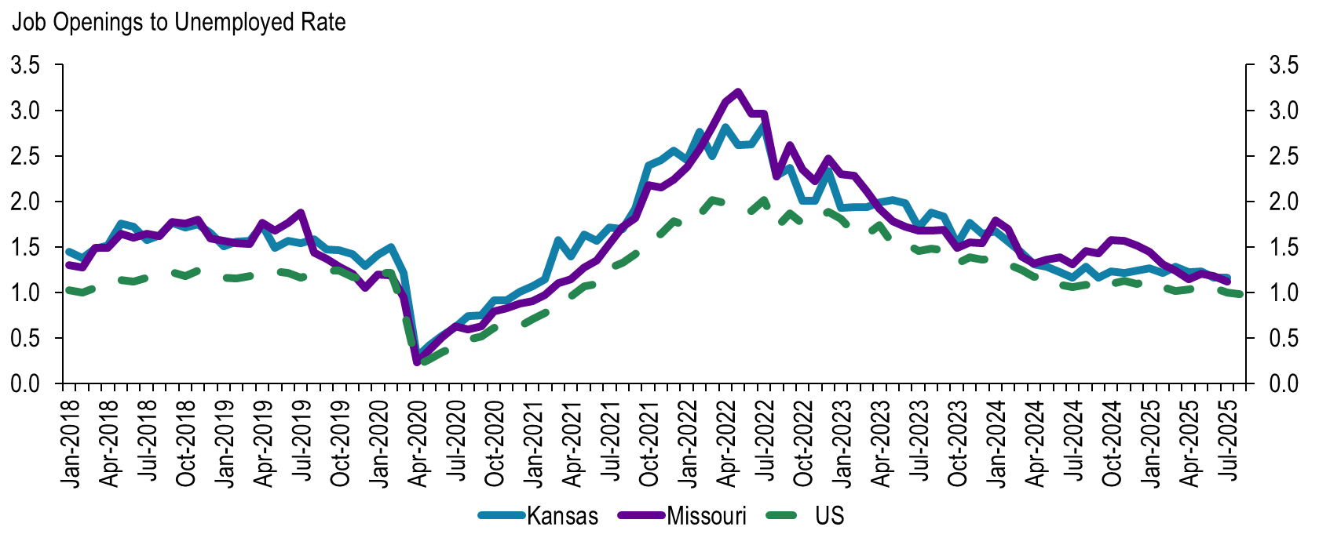
The labor market is balanced
Source: BLS, Haver

Slide 34
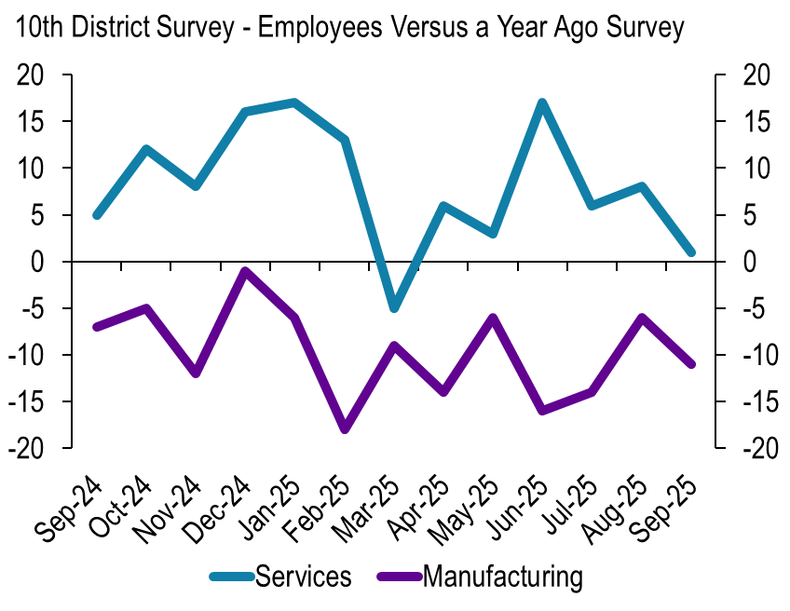
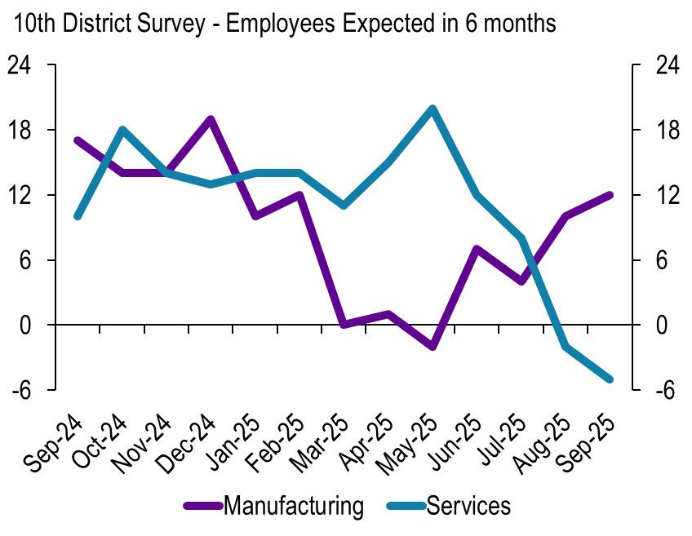
Manufacturing EMP is down, but optimism is high
Source: KC FED Survey, Haver

Slide 35
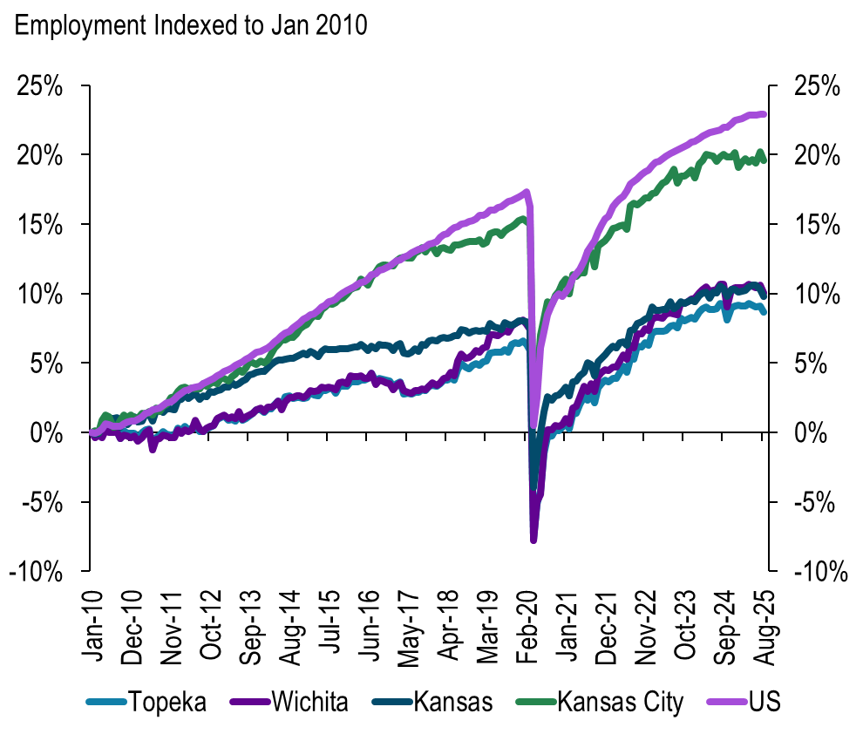
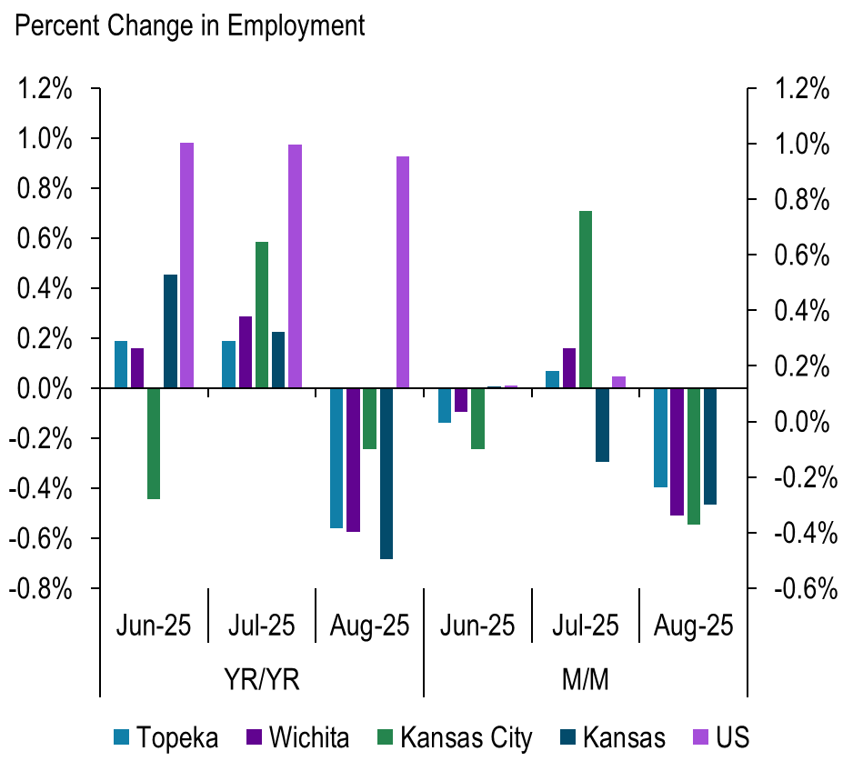
KS metro areas are slowing down more than the US
Source: BLS

Slide 36
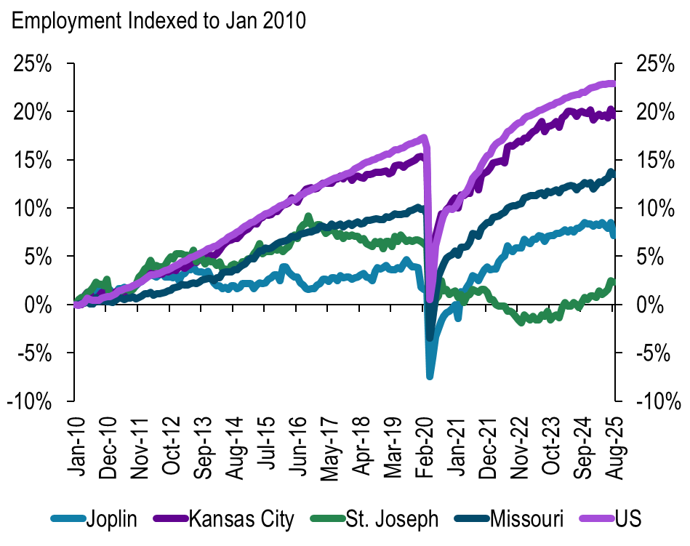
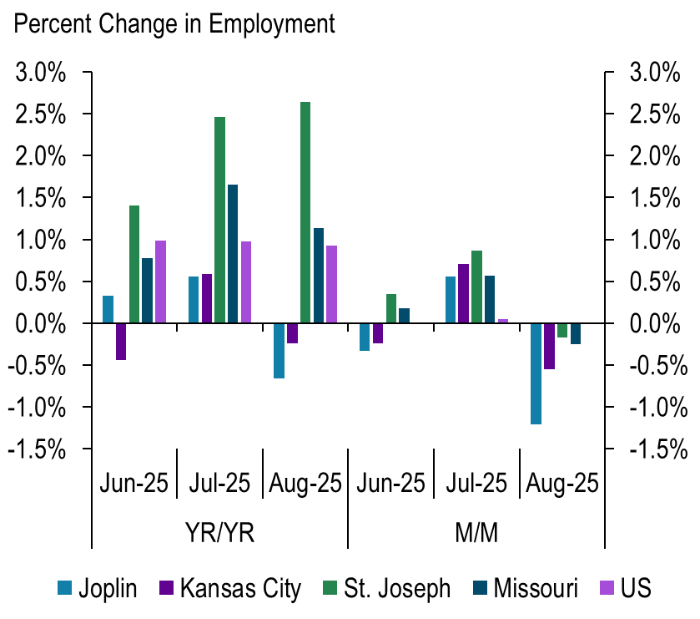
MO – St. Joseph has accelerated over the summer
Source: BLS

Slide 37
Labor expansion decision framework
Future Demand
Factors for less labor demand
Weak
Strong
Excess labor cost, margin compression
Profit growth, capacity matched
Cost savings, maintain flexibility
Missed opportunity, overworked
Productivity – AI and less labor churn
Cost stability – Healthcare and wage competition
Demand alignment – uncertainty in matching capacity
Macroeconomic risks – uncertainty
Industry shifts – mergers or increased market share
Now
Hiring
Delay

Slide 38
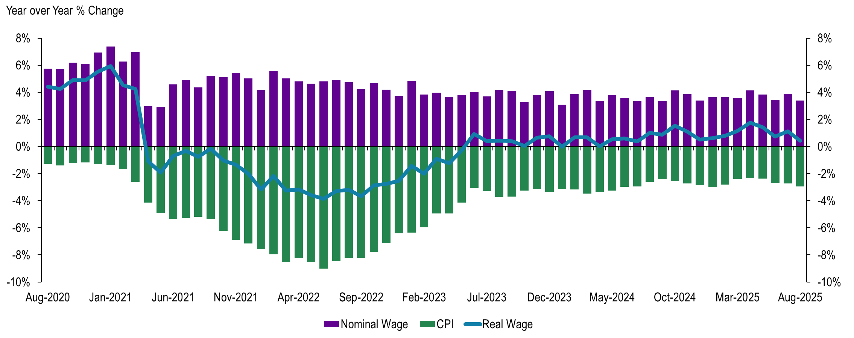
US wage growth continues to outpace inflation
Source: BLS, Haver

Slide 39
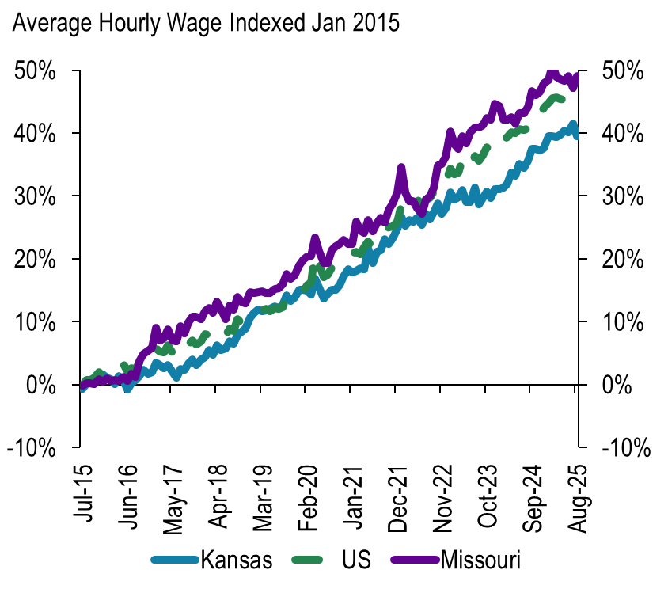
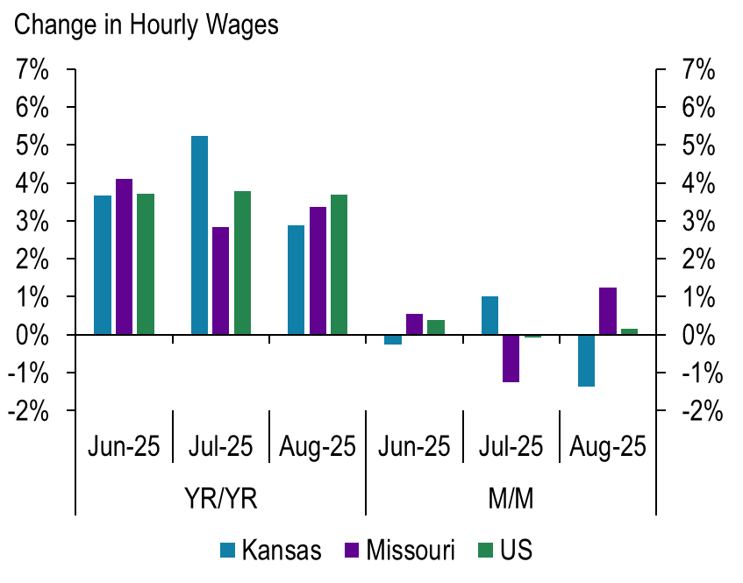
KS nominal wages are falling behind the US
Source: BLS

Slide 40

Manufacturing – Built to Last?
Examining whether strong production data signals sustained growth or temporary resilience.

Slide 41
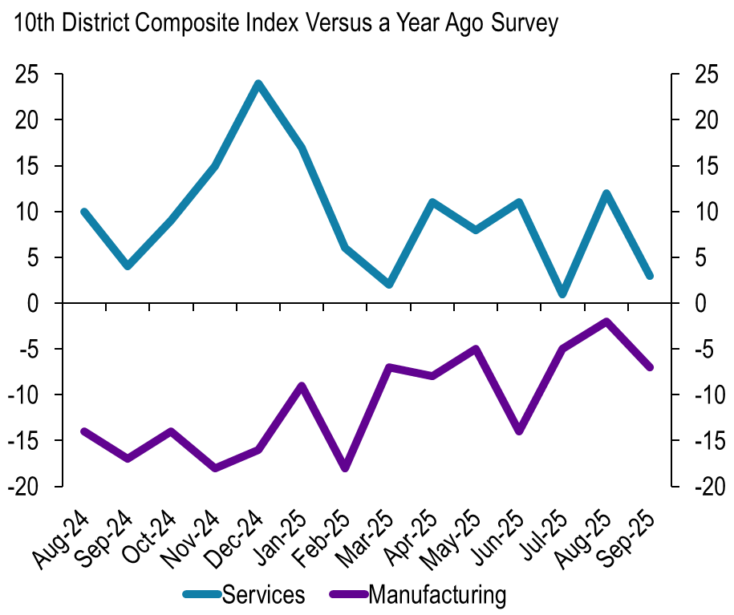
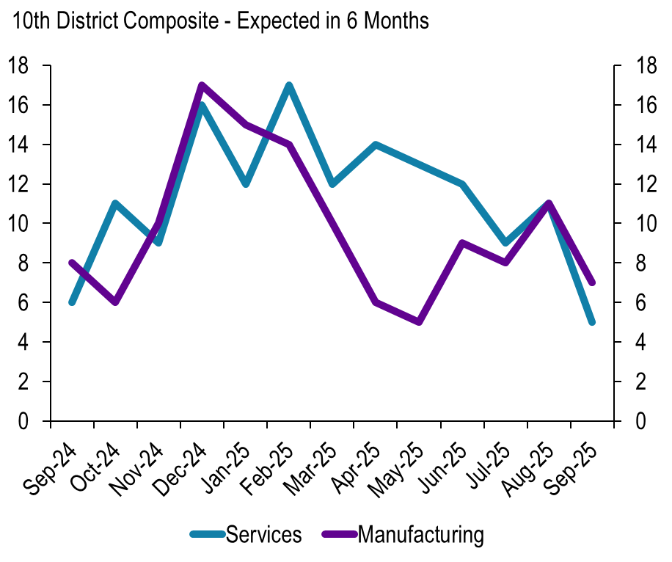
Expectations remain positive for most firms
Source: KC FED Survey, Haver

Slide 42
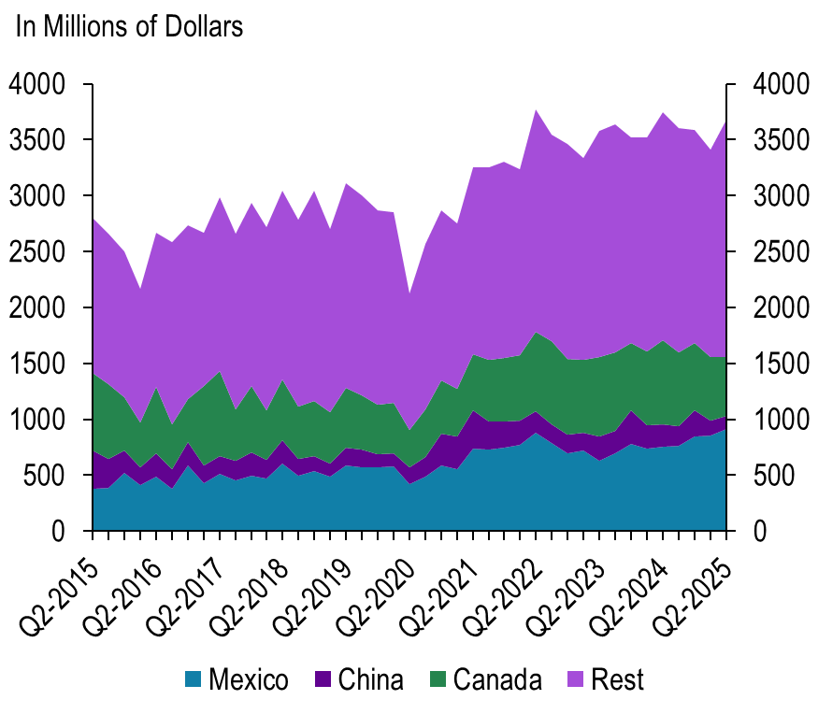
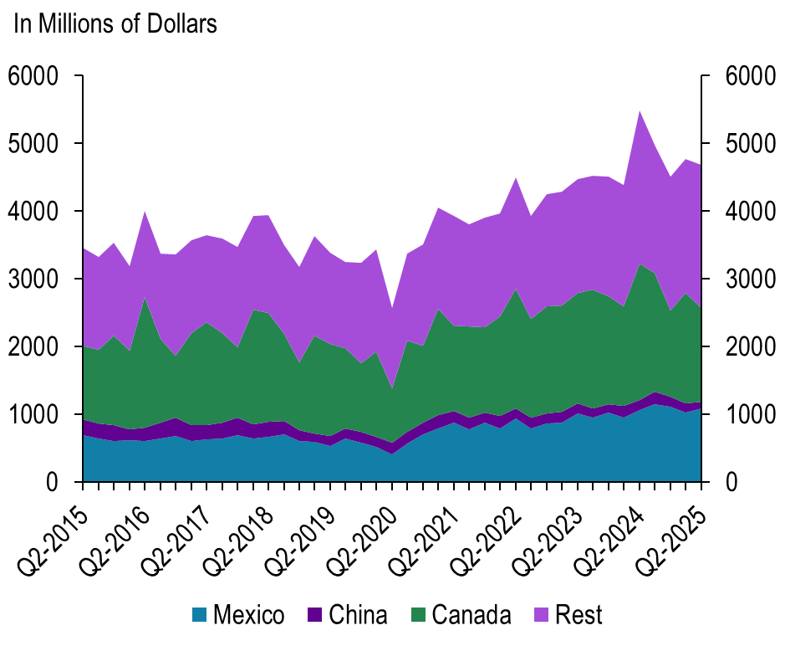
KS exports have more global exposure
Kansas
Missouri
Source: Census Haver

Slide 43
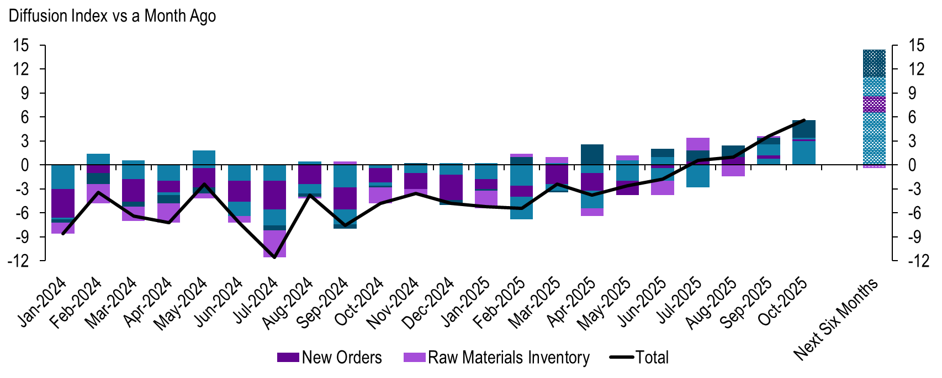
Manufacturing survey – all components are now positive
Source: KCFED Manufacturing Survey

Slide 44
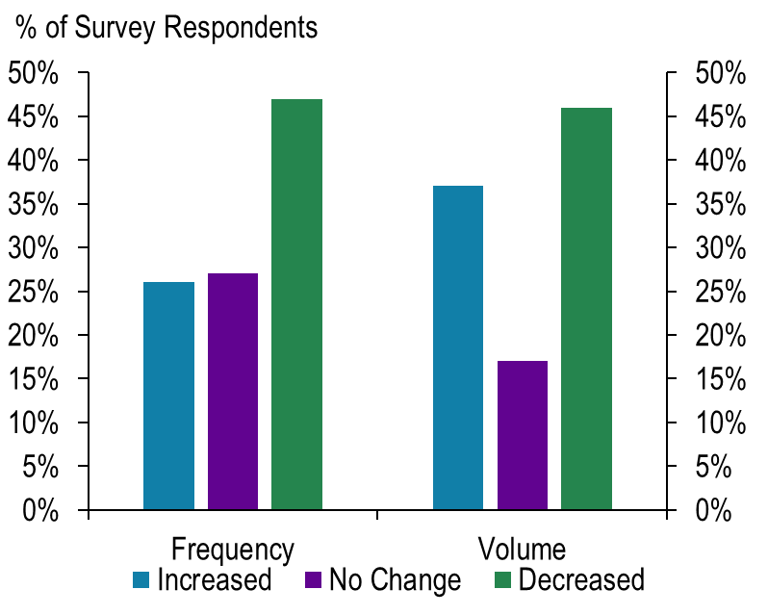
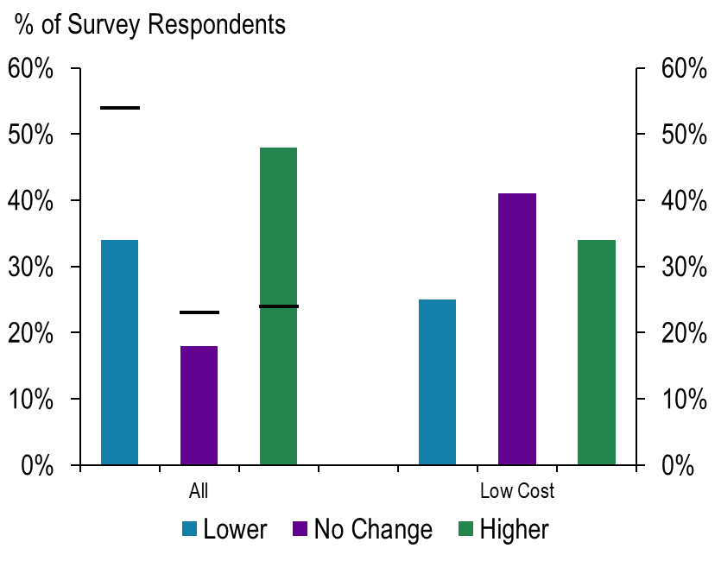
Manufacturing – demand has shifted to low cost
Source: KCFED Manufacturing Survey
NOTE: Bar Shows survey responses from August 2025

Slide 45
Globally Connectedness – Is there a Midwest advantage?
Domestic – Customers and Suppliers
Industry Examples:
Fabricated metals
Metal foundry
Consumer goods
Foreign – Customers and Suppliers
Automotive
Aerospace
Machinery equipment
Farm equipment
A more stable cost base enabled price competitiveness and stronger relative margins, gaining market share as import-reliant rivals adjusted pricing.
Industries faced pressure from rising input costs and declining global competitiveness. Strategies included tightening margins, cutting output, adjusting product lines, switching to lower-cost inputs, or passing on costs to customers.
Food production
Industry Examples:

Slide 46
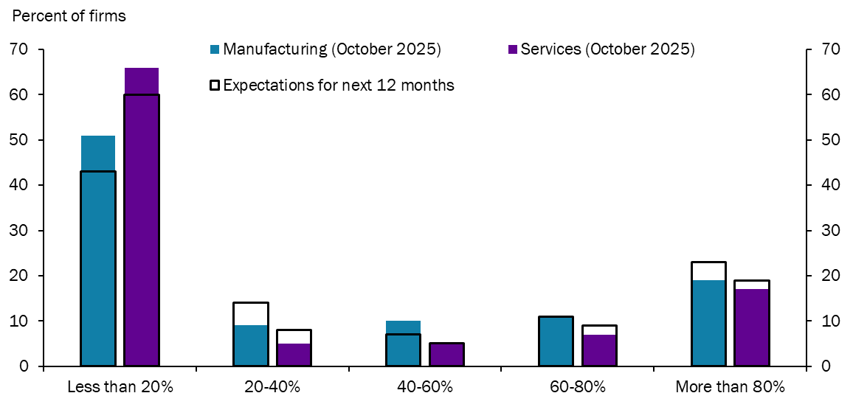
51% of Manufacturing firms are passing through 20% or less of the cost increases

Slide 47
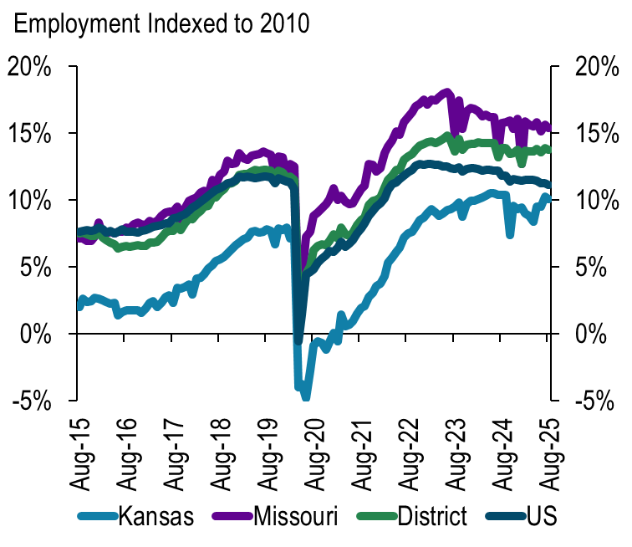
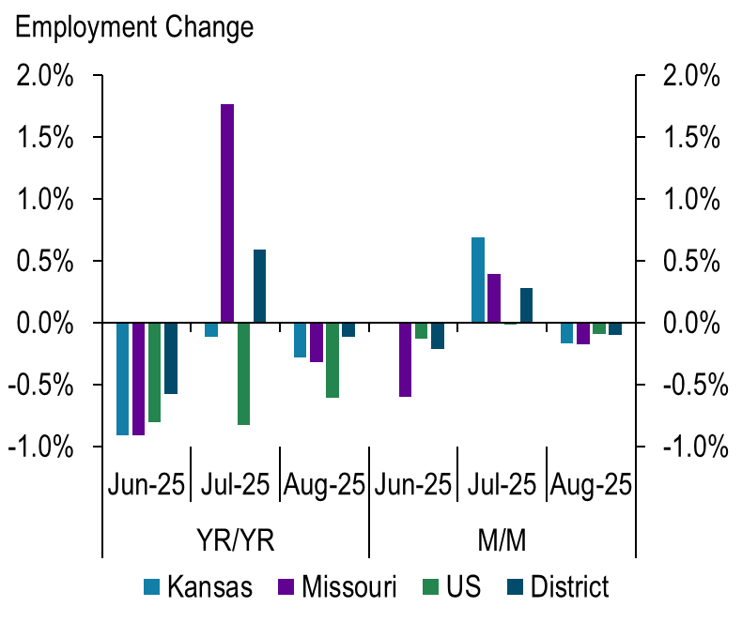
Manufacturing employment has slowed down like the US
Source: BLS

Slide 48
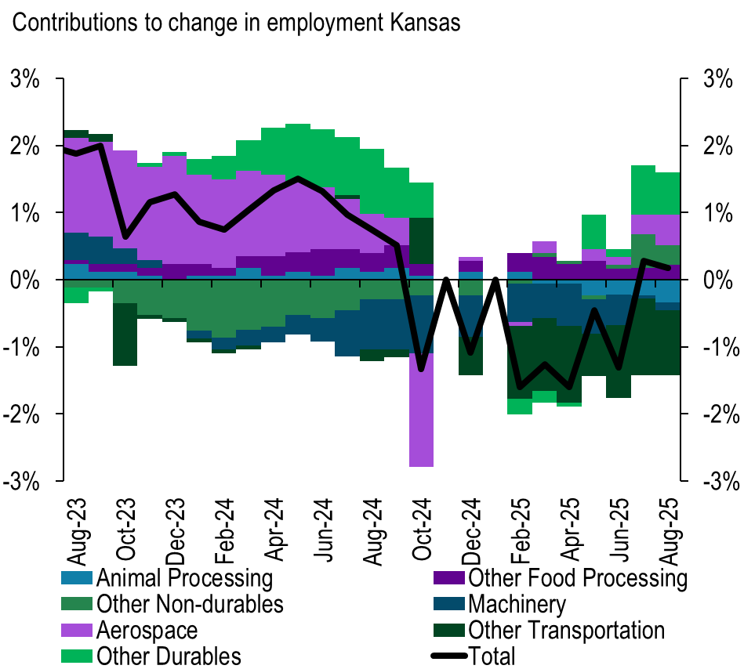
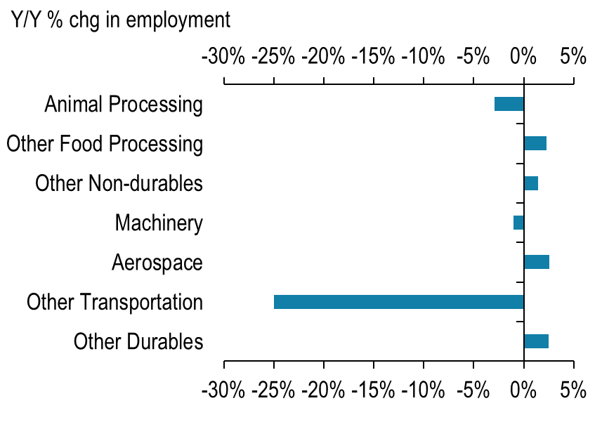
KS: Aero, other durables, and food has propped up the economy
Source: BLS

Slide 49
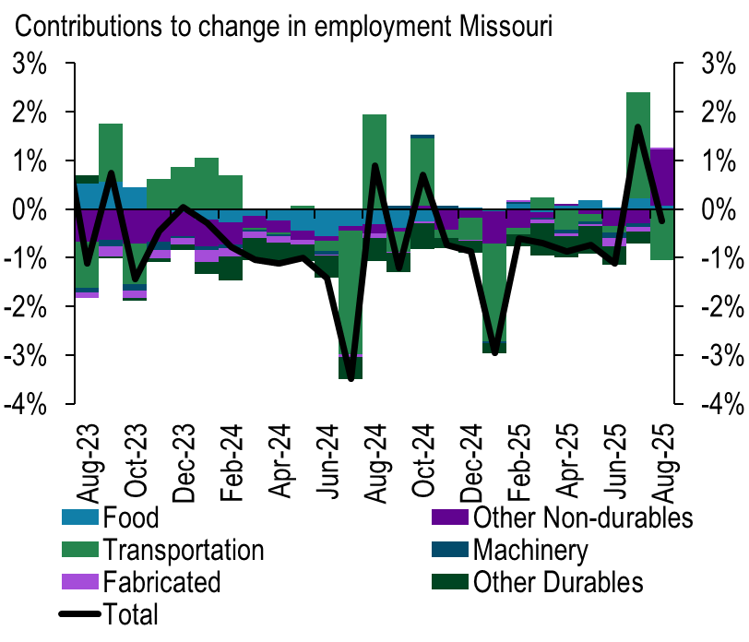
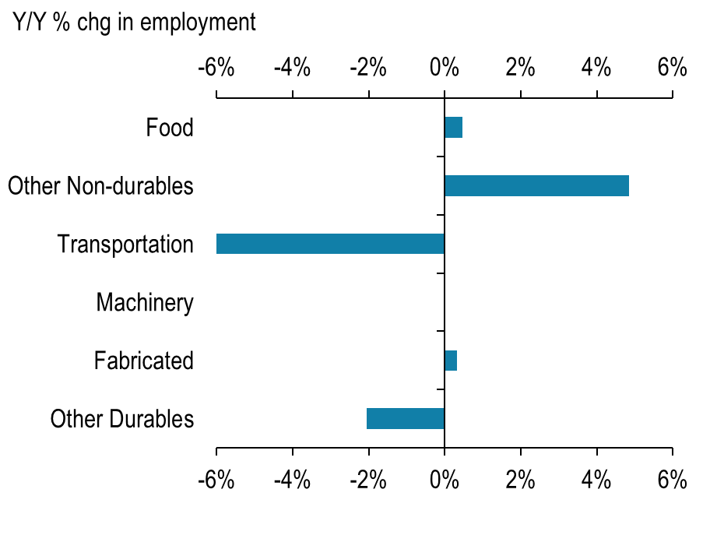
MO: Transportation employment has been volatile over the summer
Source: BLS

Slide 50
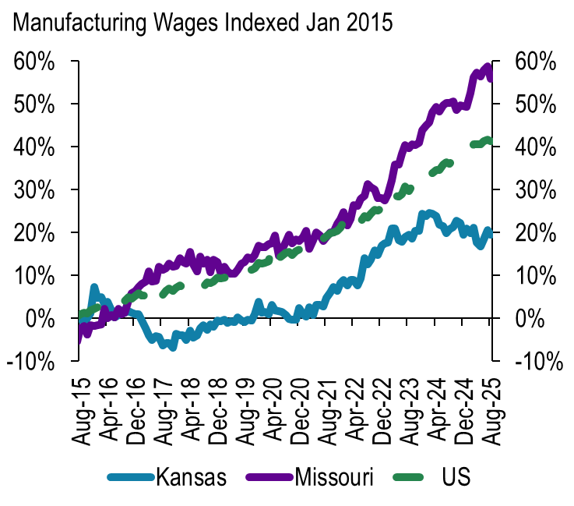
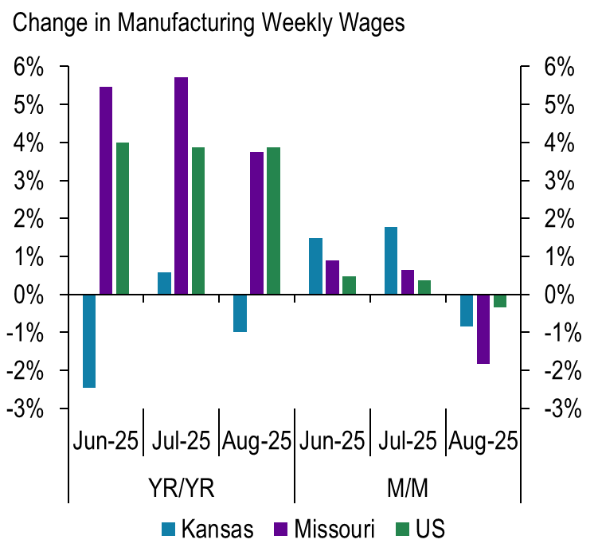
Manufacturing Wages
Source: BLS

Slide 51

Services – At your Service…For Now
Analyzing the strength of the service sector amid shifting consumer and business confidence

Slide 52
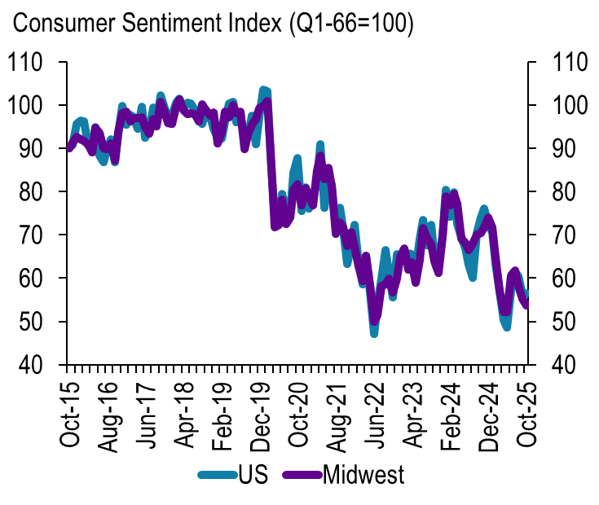
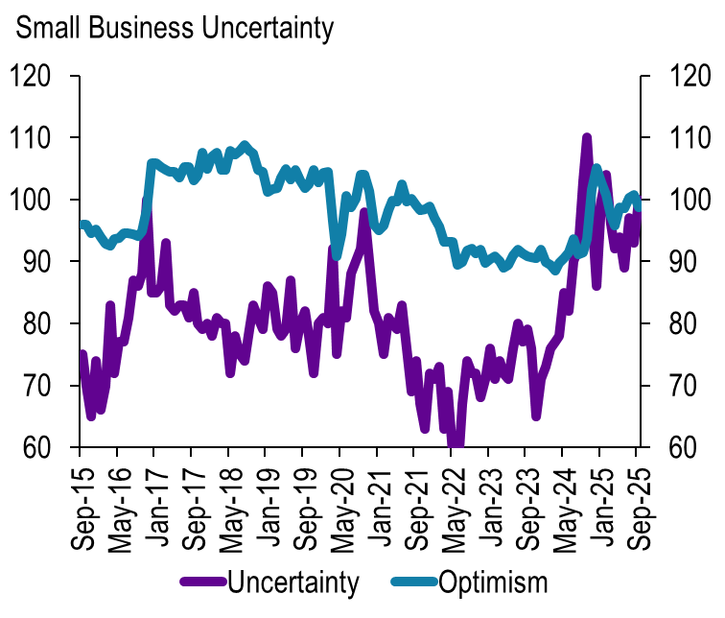
Consumers sentiment declined while business uncertainty remains high
Source: University of Michigan, Haver
Source: NFIB, Haver

Slide 53
Where did my customer go?
Segment – Heterogeneity increased: demand behavior diverged more by income and wealth
Substitution toward value: premium to mid or budget alternatives
Staycations: consumers are optimizing costs towards smaller trips
Retail and goods: value and essentials win over big discretionary purchases

Slide 54
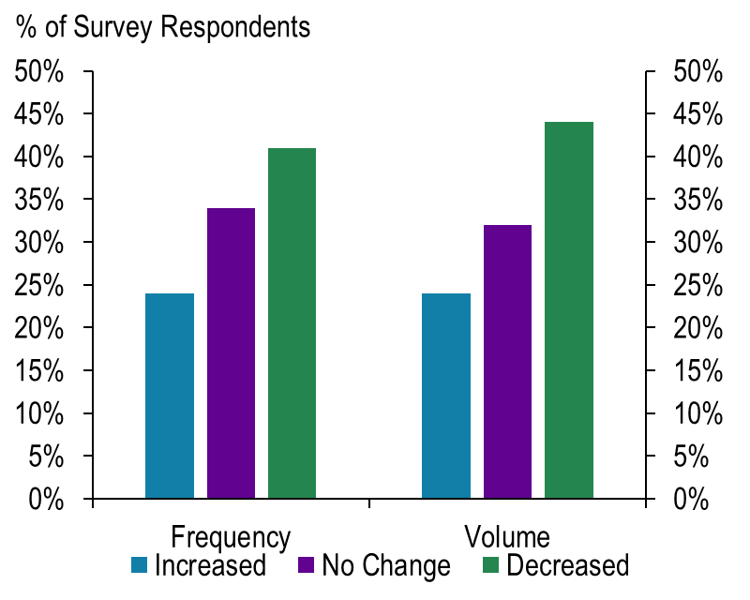
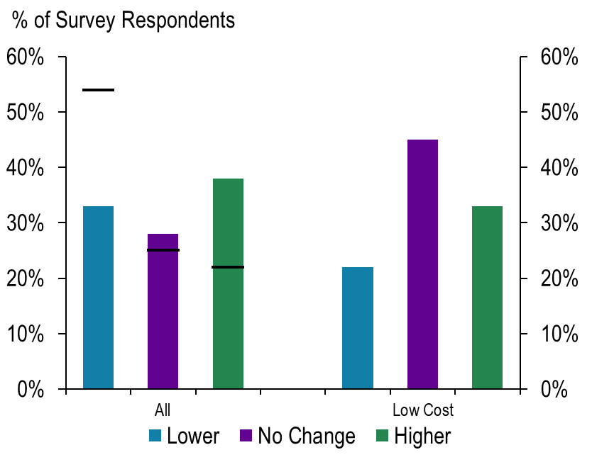
Services survey – consumers are shifting consumption to lower cost goods
Source: KCFED Manufacturing Survey
NOTE: Bar Shows survey responses from August 2025

Slide 55
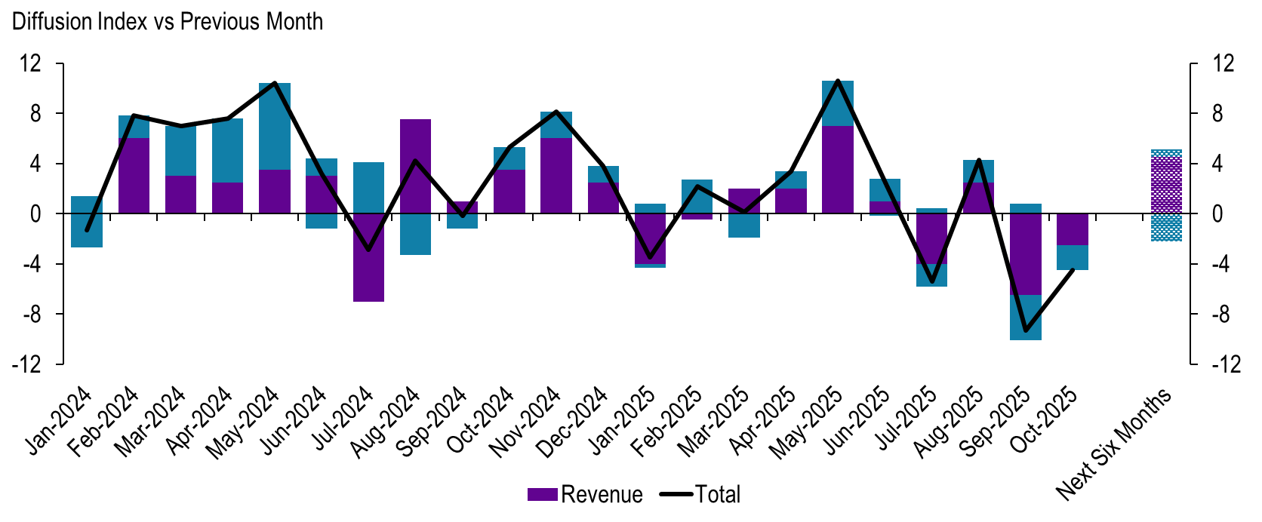
Services survey – components have declined
Source: KCFED Manufacturing Survey

Slide 56
Employment in KS and MO have cooled
Source: BLS

Slide 57
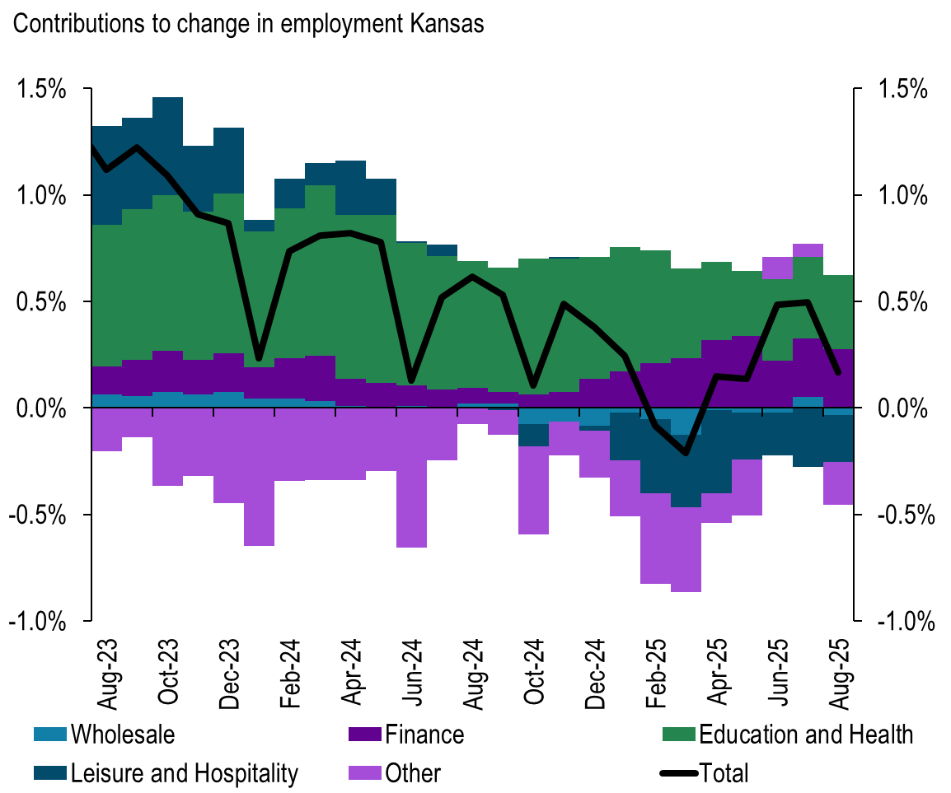
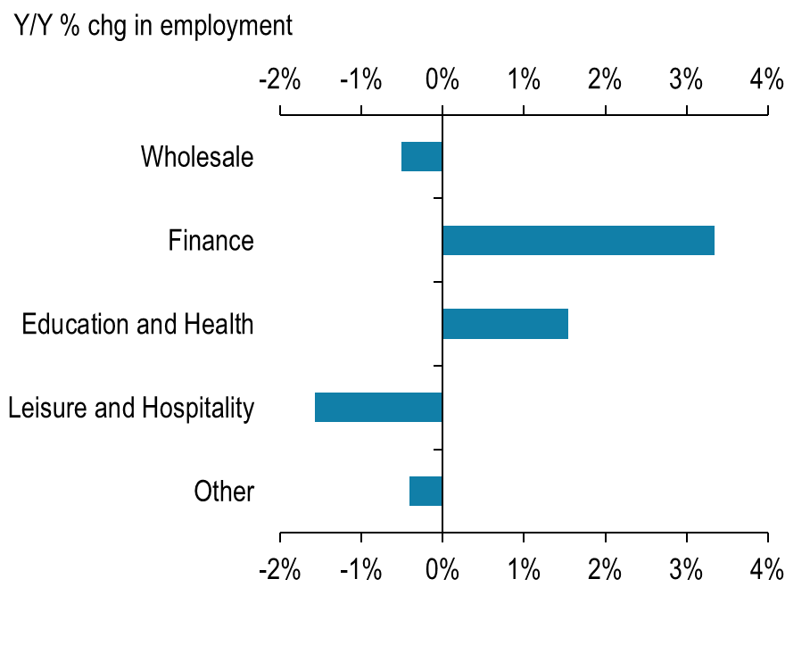
Leisure weighed down the economy- Kansas
Source: BLS

Slide 58
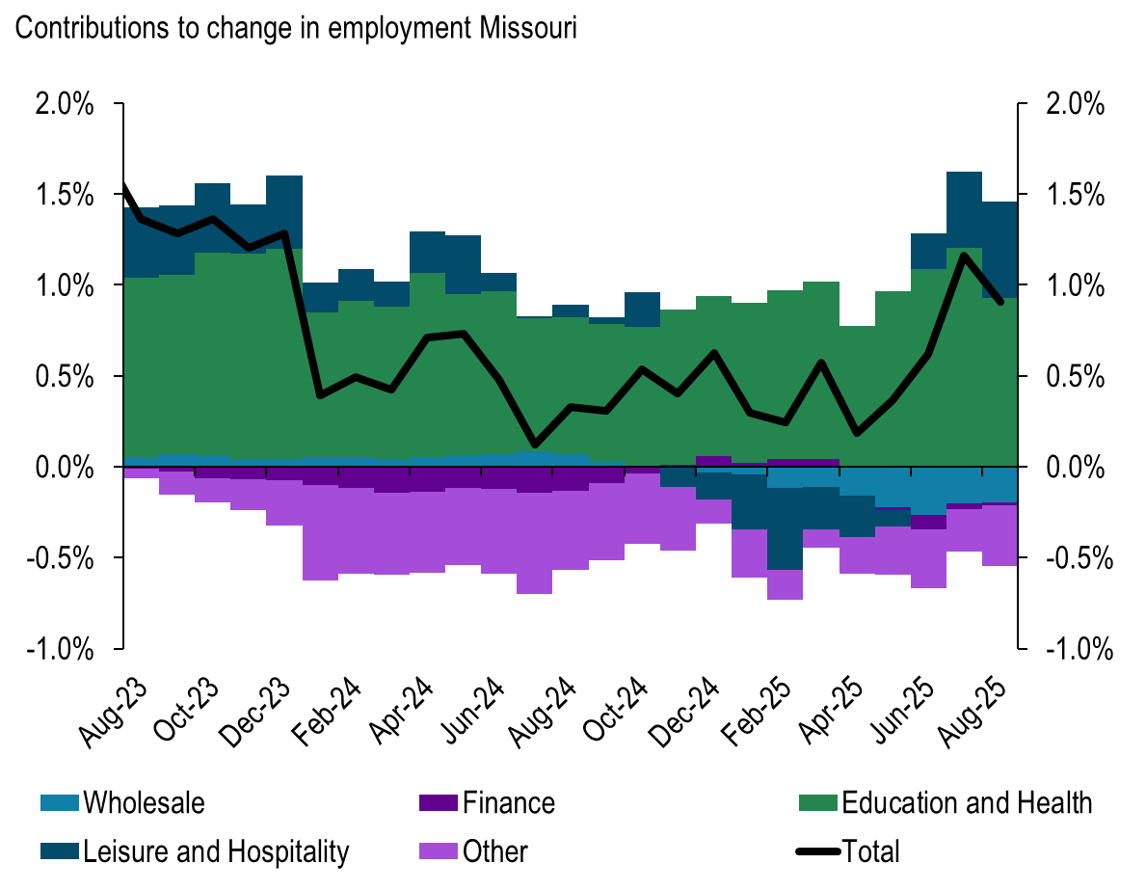
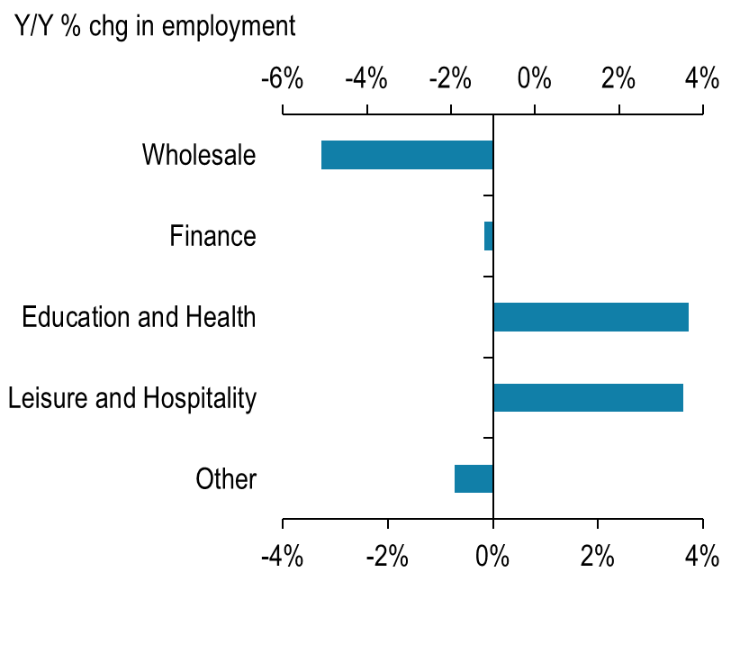
Leisure has picked back up - Missouri
Source: BLS

Slide 59
Wages
Source: BLS

Slide 60

Contact Information:

Slide 61

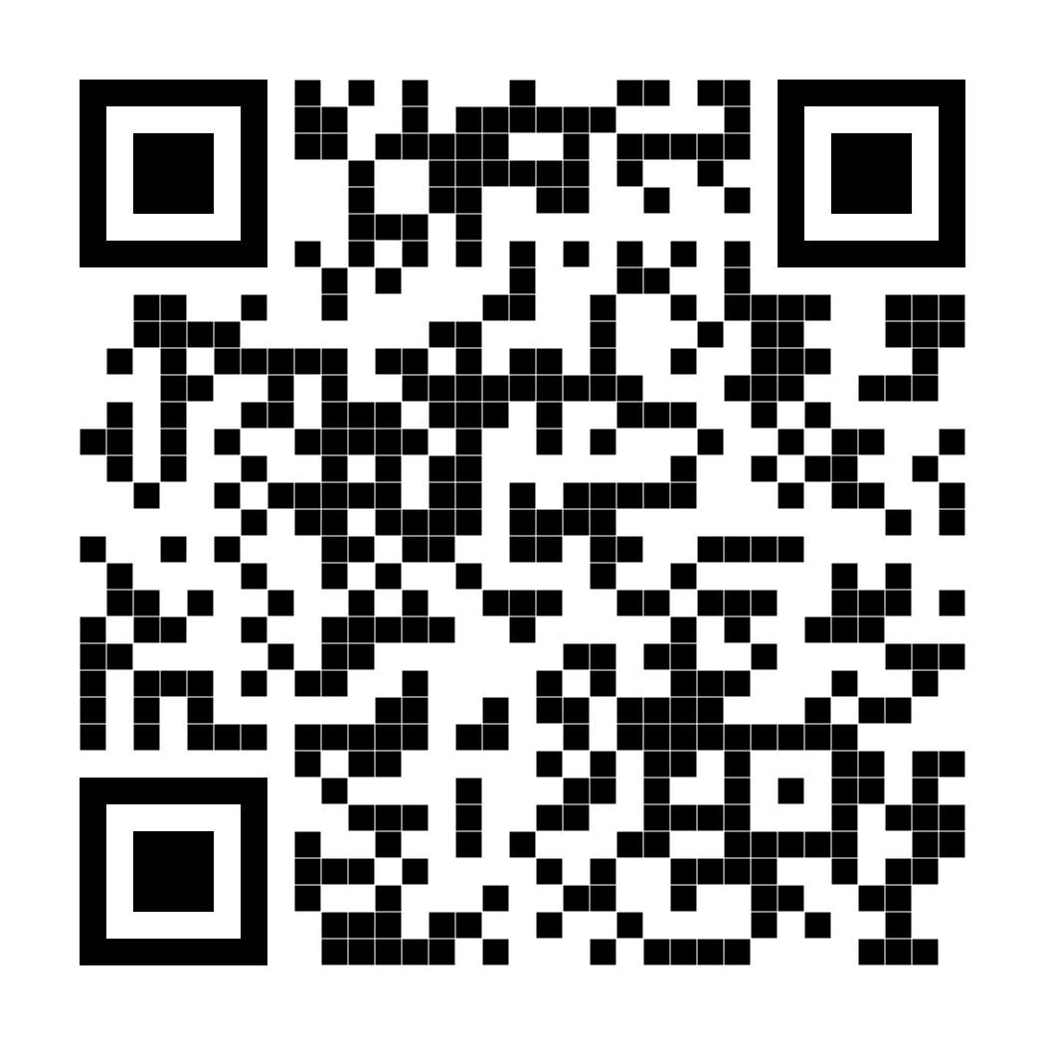
Receive Regular Updates
For more analysis of the regional economy, subscribe to receive e-mail alerts from the KANSAS CITY FED.
www.KansasCityFed.org/ealert

Slide 62

Frank Lenk – Director, Office of Economic Research; Mid-America Regional Council
Frank has been with MARC for more than 40 years.
In his role, Frank is responsible for:
  Preparing long- and short-range economic and demographic forecasts
  Estimating the economic impact of major public investments
  Overseeing the development of maps and other data visualizations to uncover the meaning in the data
  Developing metrics to measure the Greater Kansas City’s social and economic progress
He has authored/co-authored numerous reports on the Kansas City area economy, including the workforce needs of several sectors in the region.

Slide 63
2026 Kansas City Metro Economic Outlook
November 6, 2025
Frank Lenk, Director
Office of Economic Research
Mid-America Regional Council
flenk@marc.org

Slide 64
Historical Context

Slide 65
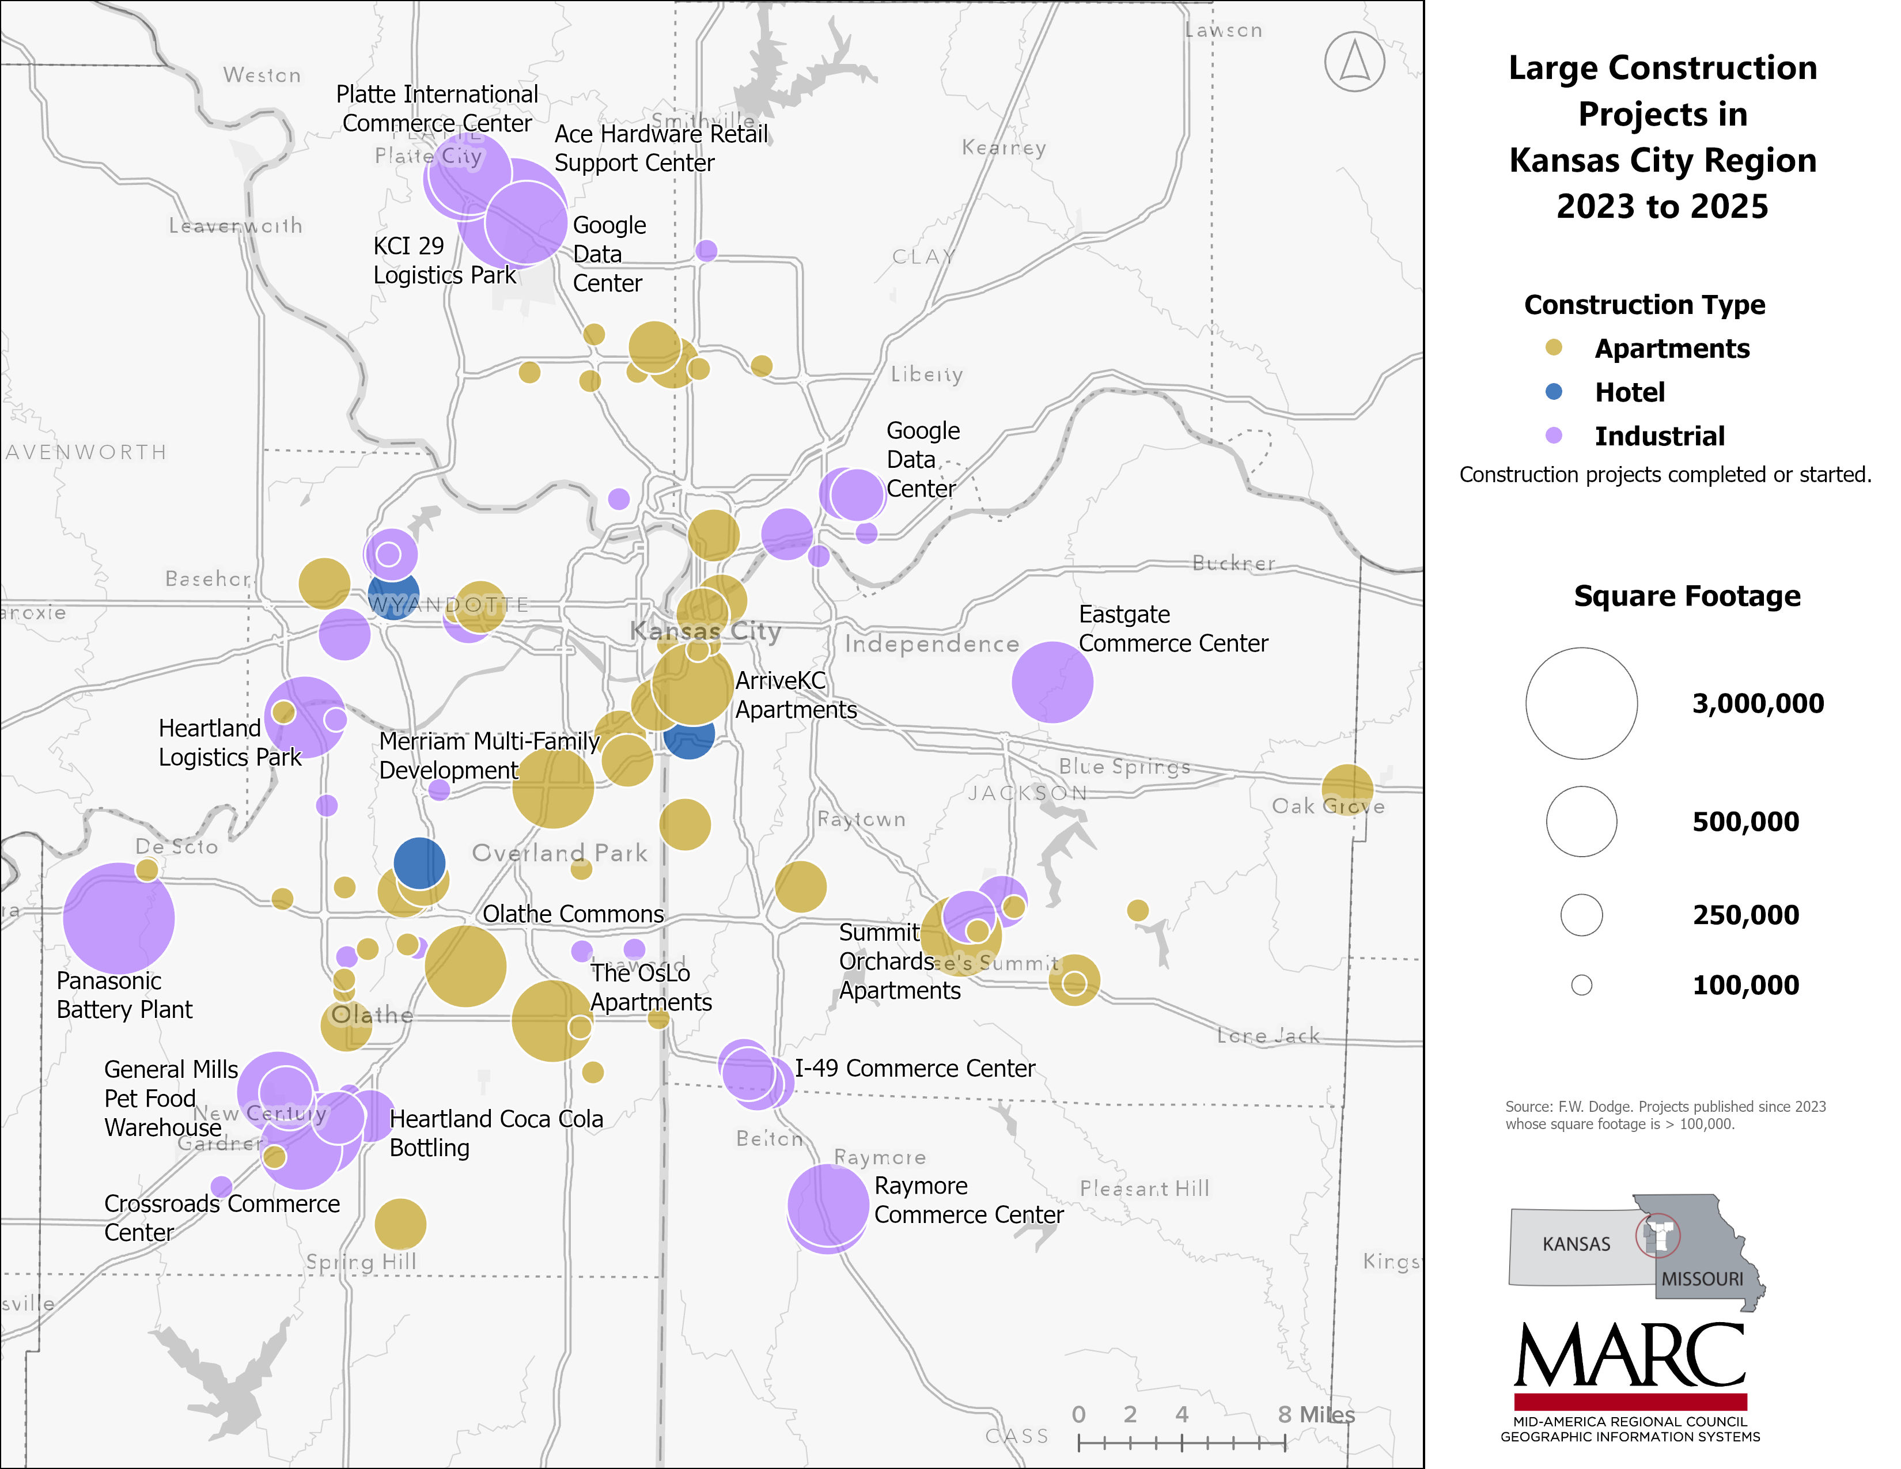
KC continues to see a large amount of new construction, especially industrial and apartments.

Slide 66
Yet the labor market is showing signs of weakening.
The last time the KC unemployment rate was this high was in 2017.

Slide 67
Most historical periods that include recessions experience roughly a doubling of the unemployment rate from the trough to the peak

Slide 68
That’s where we are today.
Moody’s calls this “Jobcession,” where growth hasn’t stopped but it is low enough that unemployment rises.
 | KC recession dating: | Unemployment Rate | Length (months) | Change (ppt) | Trough-to-Peak Ratio
Early 90's | May-90 | 4.3 | 9 | 2.5 | 1.58
 | Feb-91 | 6.8
.com-9/11 | Dec-99 | 2.6 | 43 | 3.9 | 2.50
 | Jul-03 | 6.5
Great Recession | Apr-07 | 4.6 | 34 | 4.6 | 2.00
 | Feb-10 | 9.2
Covid-19 | Sep-19 | 2.6 | 7 | 8.6 | 4.31
 | Apr-20 | 11.2
Current Period | Apr-22 | 2.2 | 40 | 2.1 | 1.95
 | Aug-25 | 4.3

Slide 69
During Covid, KC’s economy didn’t bust as low, but it didn’t boom as high. Result, KC lags US growth since Jan 2020 by 1.3%

Slide 70
Bust periods are much shorter than boom periods, meaning every cycle, KC slips a little.
Looking at the recovery period alone, KC lags US employment growth by 4%.

Slide 71
What industries are driving this difference?

Slide 72
KC’s good-producing sectors are performing better than the US, but not its service-producing.
And KC specializes in producing services.

Slide 73
Drilling deeper into the good-producing sectors, durable goods manufacturing leads the way

Slide 74
Within durable goods, computer and electronic manufacturing and transportation equipment other than vehicles out-perform the US.

Slide 75
Wholesale trade is underperforming the nation while retail trade slightly exceeds it.

Slide 76
But all parts of transportation and warehousing are performing below national averages.

Slide 77
Real estate employment growth is matching the US, but the rest of the financial sector is not.

Slide 78
Professional and business services, an historic KC economic strength, is growing significantly slower than the rest of the nation

Slide 79
Hospital employment is one of the service sectors that is outperforming the nation, but other parts of the health care system are not.

Slide 80
Arts and entertainment was the sector worst hit by Covid, and it has recovered here even more than in the US overall.

Slide 81
Federal and local government have not experienced the same growth here as in the rest of the nation, but state government employment has exceeded it.

Slide 82
Compared to the US, the best performing KC sectors are Arts, Electronic manufacturing, and transportation equipment manufacturing (other than motor vehicles). Computer systems design and motor vehicle manufacturing perform the worst.

Slide 83
When viewed in terms of the number of jobs created rather than growth rate, durable goods manufacturing overperforms the most –esp. electronic products and transportation equipment other than vehicles – followed by arts, hospitals, and construction.

Slide 84
If KC employment recovered at the same rate as the nation, it would have nearly 37,000 more jobs in August 2025.
Professional, Scientific and Technical Services accounts for nearly half of the shortfall.

Slide 85
U.S. Assumptions for the KC Forecast
University of Michigan
Research Seminar in Quantitative Economics (RSQE)

Slide 86
RSQE Forecast shows the U.S. avoiding a recession.

Slide 87
RSQE’s U.S. employment forecast shows it flattening, but not declining between 2025 Q3 and 2026 Q1.

Slide 88
Compared to historical norms of nearly 200,000 jobs added per month, RSQE forecasts job growth in the U.S. to decline to about 1/3 that level before beginning to recover.

Slide 89
The U.S. unemployment rate is expected to continue to increase despite job growth also increasing.

Slide 90
KC Employment Forecast

Slide 91
Steps to a KC employment forecast
Use RSQE forecast to update the national forecast used to drive MARC’s regional economic model, REMI.
Calibrate the national forecast to more closely match recent history.
Update the Kansas City MSA control forecast based on the new national forecast.
Calibrate the Kansas City model to more closely match recent history to create the base forecast.
Simulate the expected loss of about 10% of the federal workforce.

Slide 92
Employment growth in the base forecast for KC follows a similar pattern as RSQE’s national forecast.
But if, as expected, KC loses about 10% of its federal workforce, this would push us from flat to short-term decline.

Slide 93
A 10% reduction is about 3,000 federal employees. The economy-wide employment loss is estimated at about 6,500.

Slide 94
With overall employment increasing by nearly 16,000 in 2024, most sectors grew, led by health care. Some sectors, like administrative and support and accommodation and food, lost jobs

Slide 95
In 2025, job growth was trending to be essentially flat which means sectors gaining jobs are offset by those losing them. Once federal resignations kick in, the balance shifted to a net loss.

Slide 96
In 2026, growth rebounds, though still relatively low.
Sectors that are declining see lower losses.

Slide 97
By 2027, the region’s job growth approaches its 2024 level.
This results in the majority of industries returning to growth.

Slide 98
Conclusion
The KC economy plays a strong defense against recessions, but it’s offense during recovery seems to be missing a few pieces.
The goods sector is out-performing the nation, but it is relatively small.
The services sector, especially professional, scientific and technical services, is where the region’s job generating weakness is most pronounced.
  The loss of Cerner as a growth engine has really hurt, recalling the loss of Sprint in its heyday.
Health, advanced manufacturing, and construction are currently leading the way.
Stay tuned for the second half of our program to learn more about what the region’s business and civic community are doing to increase the number and effectiveness of region’s offensive weapons.

Slide 99
We will be taking a short break, please return at 9:45 for our Kansas City Investment Playbook Panel Discussion

Slide 100



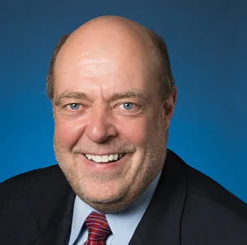
Kansas City Investment Playbook Panel
Mario Azar
Chairman & Chief Executive Officer
Black & Veatch
Dr. Ian Colrain
President & Chief Executive Officer
MRIGlobal
Douglas Girod
Chancellor
University of Kansas
Bob Page
President & Chief Executive Officer
University of Kansas Health System
Notes:
Federal Reserve Bank of Kansas City
There are 7 states included in the Kansas City District: Kansas, western Missouri, Nebraska, Oklahoma, Wyoming, Colorado and northern New Mexico.
There are three Branches in the 10th District: Denver, Oklahoma City and Omaha.
The 10th District employs about 1,600 people.
The Federal Reserve Bank of Kansas City has a nine-member Board of Directors who oversees operations and policies, and confers on economic and banking developments.

Slide 101
On behalf of the Federal Reserve Bank of Kansas City and the Mid-America Regional Council,
Thank you for attending the
2025 KC Economic Outlook Conference!

