Slide 1
Assessing Your Lending Performance
Notes:
In this module, we’ll give you tools to help you analyze your own lending. We’ll show you using methods typically employed by examiners. You’ll also have a stronger understanding of the lending test for small and ISB at the end of this module.
Point out - - get it digging and tools: there is a yellow shovel sign for items that are tools you can bring back with you throughout this module

Slide 2
Objectives
Provide you with some tools and information to help you “dig into” your bank’s performance
Notes:
The topics we’ll cover include the slide listing.
We’ll help you understand how to identify your primary products.
We’ll go over the lending assessment factors – and what we look at as examiners when analyzing your data.
We’ll give you a few simple tips for analyzing your own data.

Slide 3
What Should You Do?
Determine Primary Products
Understand Lending Assessment Factors
Analyze Your Own Data
Notes:
The topics we’ll cover include the slide listing.
We’ll help you understand how to identify your primary products.
We’ll go over the lending assessment factors – and what we look at as examiners when analyzing your data.
We’ll give you a few simple tips for analyzing your own data.

Slide 4
Primary Products
These are major loan product lines for your bank
Look at loans originated since the last CRA evaluation
Consider both dollar and number of loans
Notes:
What is your lending focus? What are the lending needs for your AAs? Are they the same in each AA. Usually examiners will look at the same primary products across AA, but may assess different primary products if needed for your bank’s focal points.
CRA is interested in originations, not outstanding loans.
Make sure you know what products the examiners identify as primary products at the beginning of your examination process.

Slide 5
Primary Products - Tools
Tools
Loan Trial
Call Report
Last CRA Public Evaluation
Notes:
In this module any time you see the yellow shovel sign – it means a tool for you. Something you can use when in your job.
This slide has some tools to help you ID your primary products:
Look at your loan trial balance, bank strategy, call report and your last PE.
Some typical primary products: Residential RE (Purchase, HI, Refi), commercial, consumer, farm

Slide 6
Lending Performance Factors
Loan-to-Deposit Ratio
Lending in the Assessment Area
Borrower Distribution
Geographic Distribution
Notes:
These are the lending factors as we introduced in the performance context They apply to all banks reviewed under small and ISB.
LTD% does not use primary products – it is the ratio for all lending from the call report.
The other lending performance factors will be assessed based on your primary products.
We’ll talk about each in some detail.

Slide 7
Loan-to-Deposit Ratio
Measures overall lending levels
Calculate ratio using average quarterly ratio reported on UBPR since last CRA evaluation
Compare your bank to similarly situated institutions (SSI) and peer group
Understand any performance context that impacts your ratio
Notes:
Lets look at LTD% first - It gives sense of overall lending.
What is a SSI? It may or may not be direct competitors. Need to be similar in product focus and size. This may be hard to determine for some banks. We’ll talk about this more with the next slide
Ask participants: What factors impact LTD%? Especially important if relatively low compared with SSI. Consider internal and external factors. Hopefully you’ll get some internal and external examples.
External: Loan demand, economic indicators like unemployment, demographics like area losing population and relatively old population, interest rate environment to some extent
Internal: Lending policies and product offering (less likely to be a reasonable mitigating factory) Loans sold, recent acquisitions, trend of ratio, regulatory actions or restrictions
These are all part of your performance context.
Not used in large bank analysis

Slide 8
Loan-to-Deposit Ratio What is an SSI?
Similar in size
Serve same or similar market
Similar products and services
Notes:
You can use the FDIC Summary of Deposits to see what other institutions report deposits in your county/MSA. We show you this site in the CRA tools module. This won’t include credit unions.
UBPR state peer may be good starting point, but need to look at more closely since it provides a large and broad peer group.
Try to find institutions that offer similar products/services. If possible in same AA, sometimes need to go beyond AA and that is okay if the bank and its location are similar to your bank.
You may be able to identify the SSI from the last exam, although this may not be useful since banks may change, especially for small banks on a 4-5 year cycle.

Slide 9
Loan-to-Deposit Ratio Tools Where do you get the information?
Uniform Bank Performance Report
FFIEC Website
Page 10, Net Loans & Leases to Deposits
Get Ratio For Each Quarter Since Last CRA
Use This Information for Your Bank and For SSI
Compare Average for SSI and Range for SSI to Your Bank
Notes:
This slide is a tool for you to take home. Again, all the slides with the two shovels in this module represent job tools – they help you dig into your lending information.
The slide shows you how to use the UBPR to get your LTD% and the ratio for SSIs.

Slide 10
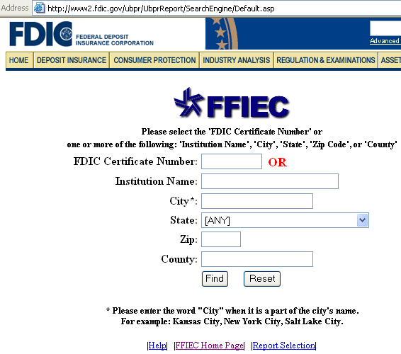
UBPR – Insert Bank Info and Hit Find
Notes:
This slide shows the UBPR website. This way you will have the correct address.
Just type in your information. The search doesn’t have great fuzzy logic so you may want to use the cert number if known. Otherwise, city, state and a little bit of the bank’s name.

Slide 11
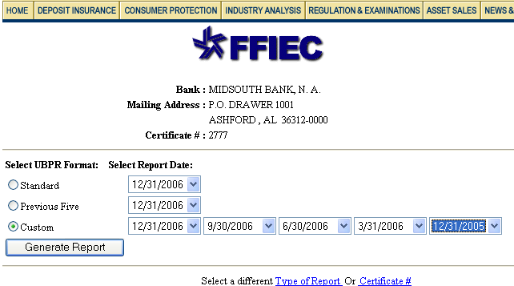
UBPR – Select Custom Pick Dates
Notes:
You can get one quarter or up to 5. Select custom and you can select current and last four quarters using the drop down menu.
You can do this again using older dates to get all quarters since your last CRA evaluation.

Slide 12
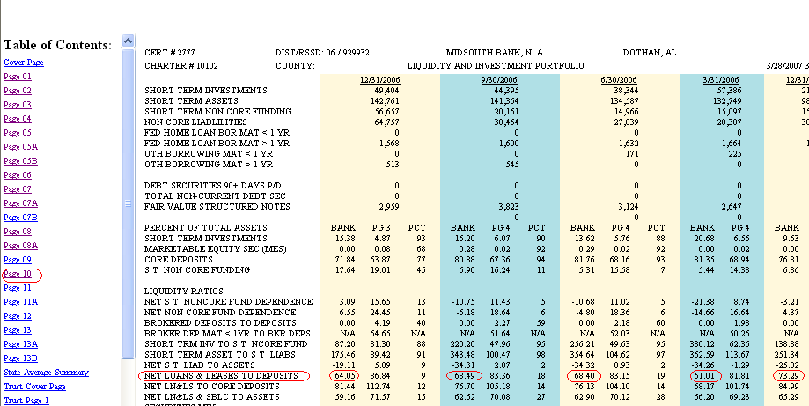
UBPR - Page 10 Net Loan & Leases to Deposits
Notes:
This shows the number you are looking for and the website lets you download into excel or print the UBPR by individual page.
The red circles show you are on page 10, and need the Net Loan & Leases to Deposits. Be careful to select the bank ratio and not the peer.

Slide 13
Loan-to-Deposit Ratio Example
BANK NAME | CITY | ST | Total Asset 2007Q1 | NET LN& LS / TOT DEPS |  |  | Average LTD %
 |  |  |  | 2006Q4 | 2006Q3 | 2006Q2
A | Anycity | AL | $626,843 | 61.36 | 60.44 | 61.48 | 61.09
B | This City | AL | $217,568 | 84.19 | 97.54 | 98.5 | 93.41
C | Anycity | AL | $241,998 | 98.29 | 90.81 | 85.52 | 91.54
D | Anycity | AL | $244,378 | 97.31 | 97.79 | 90.08 | 95.06
E | Anycity | AL | $271,759 | 73.96 | 68.88 | 70.14 | 70.99
F | Anycity | AL | $79,018 | 90.85 | 86.89 | 86.11 | 87.95
 |  |  |  |  |  | Total | 83.34
Our Bank | This City | AL | $205,122 | 76.01 | 74.29 | 78.89 | 76.40
Notes:
This slide contains a made up example to show you an easy way to organize your data and compare with SSI.
Send the report to excel, combine all the SSI information, and you can add a column to the right and have excel calculate the average LTD% for each bank.
I have the subject bank on the bottom line. You can easily compare this ratio at 76% to the average for all SSI at 83%. You should also look at the range, so I put the lowest and highest in italics. The subject bank falls within the SSI range and is slightly lower than the average. This represents satisfactory performance.

Slide 14
Lending in Assessment Area
Measures level of lending within all of your assessment areas
Use your loan originations. Consider using a sample of loans for primary products, or your whole portfolio, or HMDA loans
Geocode loans
Determine percentage within assessment area by # and $
Want 50% or higher in the assessment area
Notes:
Lending in AA also gives an understanding of your level of lending and some information about how much of your lending goes back to your community.
We’ll use your primary products. If you have HMDA or CRA data we can use all of the data instead of a sample. Remember even if you have the ability to calculate this for all of your loans – stratify by loan type – you don’t want to end up with weak performance for a type of loan that is masked when using overall numbers. For example, this may happen if consumer lending is great, but commercial lending isn’t as strong, when you evaluate the number of loans in the AA it looks great overall since many banks have a larger number of consumer loans.
You can use FFIEC geocoder to geocode loans, another tool included in the CRA Toolkit module.
Make the points on the slide: look at # and $, and must have 50% for satisfactory without strong performance context.
You set assessment area – not examiners, so the numbers should be relatively high.

Slide 15
Lending in Assessment Area Example
 | Number of Loans In AA |  | Dollar of Loans In AA
Loan Type | # | % | $ | %
Home Purchase | 125 | 69 | 13,971 | 45
Home Improvement | 15 | 68 | 924 | 72
Home Refinance | 99 | 85 | 12,355 | 87
Commercial | 26 | 87 | 3,659 | 79
Total | 265 | 77 | 30,909 | 61
Notes:
Here is an example of capturing lending in AA in table. This is similar to many SB/ISB PE tables.
This shows that performance may differ between products.
This is a combined analysis – not separated by each AA if there is more than one
Ask Participants: It also shows a difference in the number of loans reviewed do you know why? Answer – HMDA, the table includes all HMDA reported originations so shows a large number of residential real estate loans. Commercial loans were reviewed using a sample so the table includes a much smaller number of commercial loans.

Slide 16
Lending in Assessment Area What to look for
Majority of loans by number and dollar should be inside the assessment area
If not, be able to explain why

Slide 17
Borrower Distribution
Measures how well you have met credit needs for low- or moderate-income individuals and small businesses and farms
Most complex factor to analyze
Compare your performance to demographic information
Only look at loans in your assessment area
If you have more than one assessment area, analyze each separately
Notes:
Measures your loans to LMI and small businesses and farms. Not as concerned with middle- and upper-income borrowers. May look at middle if performance context reason like housing costs in resort areas.
Borrower distribution is usually the most complex analysis.
Only uses loans in your AA. Should look at each AAs results separately if multiple AAs, as results may be different
ASK Participants: If you have two primary products (say consumer and commercial lending) and two assessment areas – how many loan samples would examiners analyze? Answer: one sample for each loan type for each AA.

Slide 18
Borrower Distribution What do you need for your data?
Individuals
Income used for credit decision
Determine income category for each using HUD Updated MFI for year loan originated
HUD UPDATED MFI http://www.ffiec.gov/cra/censusproducts.htm#censusdata
Commercial/Farm – Gross annual revenues
Income used for credit decision
Determine if small business or small farm
Notes:
This slide shows what income information is used for borrower distribution analysis.
This slide has the link to get the updated HUD MFI. You should compare each loan to this number for the correct year.

Slide 19
Borrower Distribution What do you need for your data?
Income Levels for Individuals
Low-income < 50%
Moderate-income 50% to < 80%
Middle-income 80% to < 120%
Upper-income 120% and higher
Business/Farm Sizes
Gross Annual Revenues of less or equal to $1 million = small business/farm
Notes:
Good slide to help you remember what makes up each category.
Remember don’t combine LMI when analyzing data.

Slide 20
Borrower Distribution What do you compare your data with?
Loan Type | Comparables | Comparator Data Source
Residential RE | Families | US Census
Consumer | Households | US Census
Commercial | % of AA businesses with revenues of $1 million or less | Dun and Bradstreet
Farm | % of AA Farms with revenues of $1 million or less | Dun and Bradstreet
If HMDA or CRA reporter, also refer to aggregate data as a comparator (FFIEC website)
Notes:
This slide gives you the comparables examiners use, and their source of information.
US Census – you can get this from the Census website down to county or MSA levels.
D&B may be harder to get – if use CRA software you should be able to get this information. You may be able to get it from someplace in your bank, a local chamber of commerce, you may want to see if another bank in your AA has a recent PE or look at your last PE which will not give you perfect data, but may give you some idea of the business breakout in your area.
HMDA aggregate data at FFIEC.gov/HMDA/On-line reports
CRA aggregate data at FFIEC.gov/CRA/On-line reports

Slide 21
Borrower Distribution What to look for
Focus is on originations to LMI borrowers and small businesses and farms
Loan originations should mirror or exceed demographic figures
If gaps are noted, be able to explain why

Slide 22
Geographic Distribution
Measures how well loans are distributed throughout your assessment area and among tracts of varying income levels
Only look at loans within the assessment area
Compare your lending to demographic information at the tract level
If you have more than one assessment area, analyze each separately
Notes:
Geographic distribution is similar to borrower – but looking at where your loans are located. Again only loans in the AA
Ask Participants: what areas are we most concerned about: LMI areas.
Look at each type of primary loan separately and each AA separately.

Slide 23
Geographic Distribution What do you need for your data?
Geocode your loans in the assessment area
Determine income-levels for each census tract - you can use the Census information on the FFIEC website
FFIEC Census Reports http://www.ffiec.gov/webcensus/default.aspx
FFIEC Windows Application
http://www.ffiec.gov/census/winApp.aspx
Notes:
This slide shows how you can find Census reports through the FFIEC website and this is also in the CRA Toolkit.
Remember CT incomes only change with a new census.

Slide 24
Geographic Distribution What do you compare your data with?
Loan Type | Comparables (By Tract Income Level) | Comparator Data Source
Residential Real Estate | % Owner-Occupied Housing | US Census
Consumer | % Households | US Census
Commercial | % Businesses | US Census
Farm | % Farms | US Census
If HMDA or CRA reporter, also refer to aggregate data as a comparator (FFIEC website)
Notes:
This slide shows what we compare lending data with and the source of the information. Good news is that all the geographic comparative information comes from the Census.

Slide 25
Geographic Distribution What to look for
This test focuses on the LMI tracts
If AA contains only middle- and upper-income tracts, this will also be reviewed
Review loan distribution in these tracts compared to demographic data
If gaps are noted, be able to explain why

Slide 26
Community Development Loans
Review loan trial
Flag loans in amounts in excess of $1 million that meet a CD purpose
Flag multi-family loans that meet a CD purpose
If ISB, may also flag loans under $1 million if they are not reported under HMDA
Notes:
Keep track of your CD loans between examinations and have documented support for why you believe the loan qualifies as a CD loan
CD activities should be in relation to capital levels

Slide 27
Questions?

